Slide 1





ACHIEVEMENTS 2022-2023

Slide 2

Gold Level Award- School Enterprise Challenge 2021

Slide 3
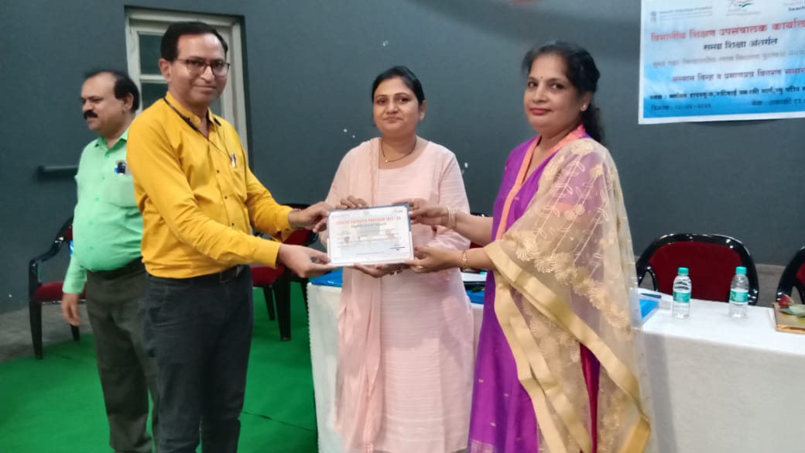
School has been awarded as Swachh Vidyalaya Puraskar 2021-2022, District Level Award, S Ward with total score of 104% and a rating of 5 stars.

Slide 4
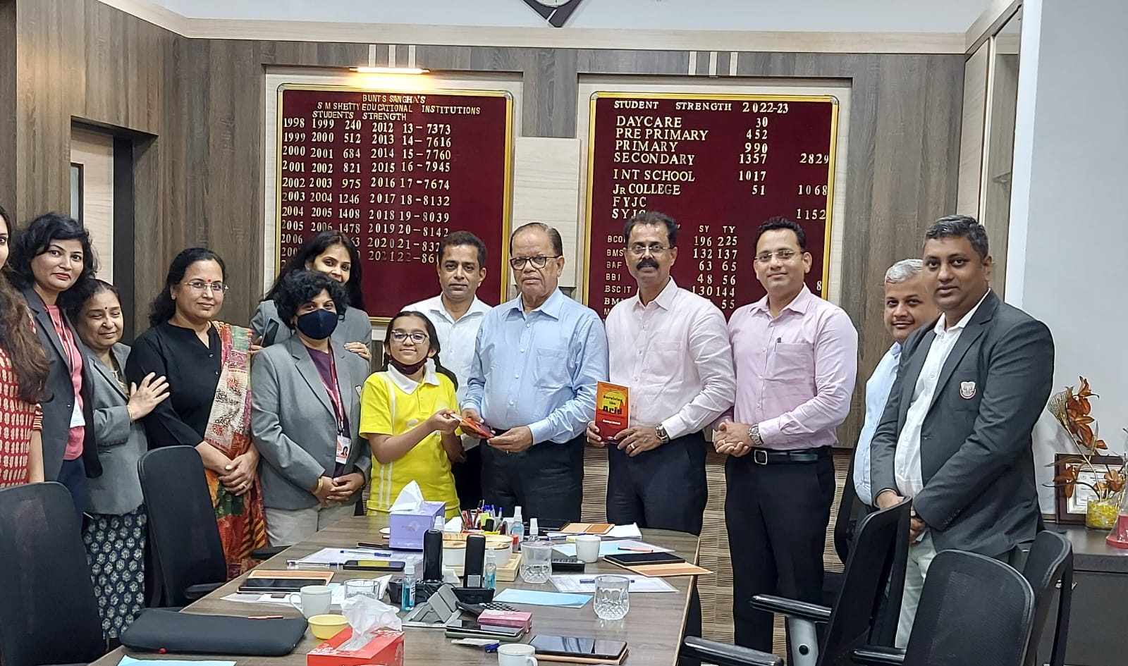
Ananya Harish, a budding author had her first book launched on Sunday, 3rd July.

Slide 5
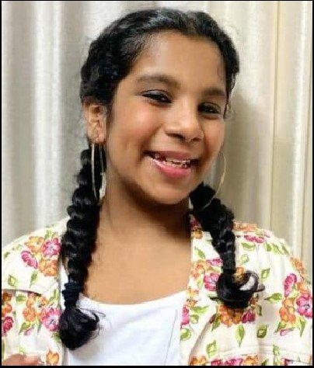
Om Menon Sankar from IGCSE I secured first place in Paper Sculpture in the event Explorare 2022 organized by Campion School, Mumbai.

Slide 6
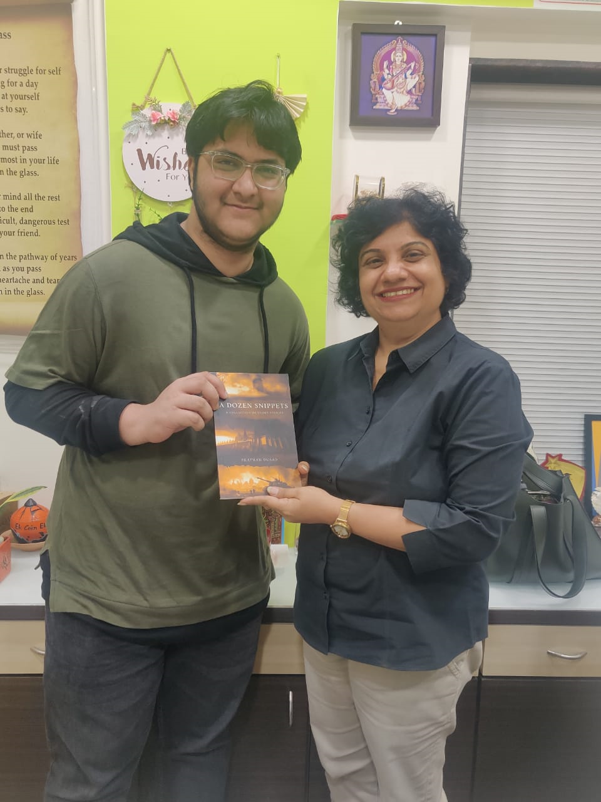
PRATHAM DUSAD, IBDP STUDENT YOUNG AUTHOR, PUBLISHED BOOK - A DOZEN SNIPPETS

Slide 7
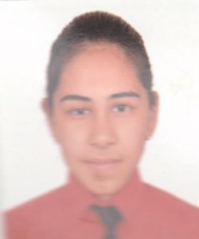
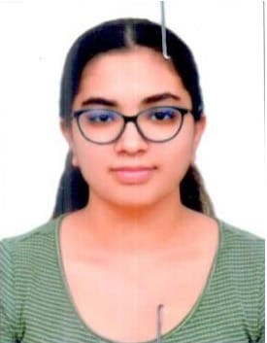
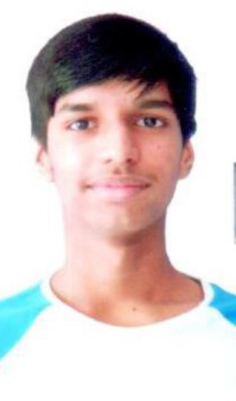
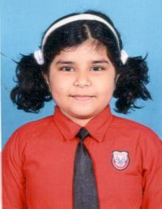
Aarush Bathula, Vaanya Sharma, Trisha Saini, Om Menon, Megan Salian are the winners at Fairgaze MUN

Slide 8
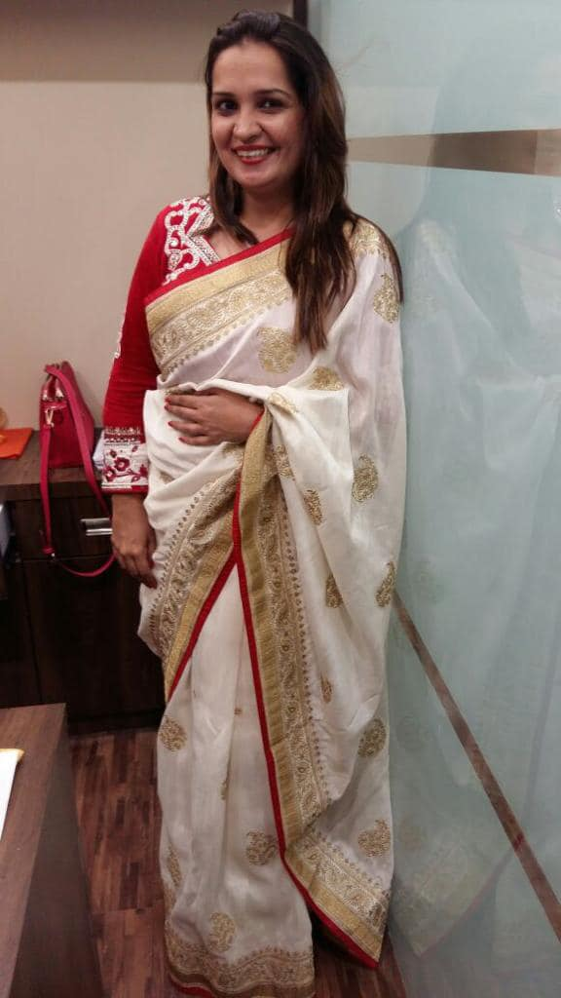
Sumeet Kaur Kesar, teacher has awarded as the “SOF BEST DISTRICT TEACHER AWARD - 2021-22” for SOF National Science Olympiad for the year 2021-22.

Slide 9
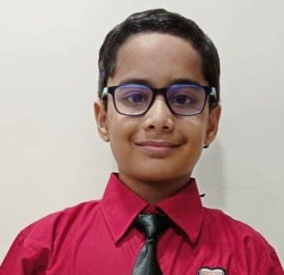
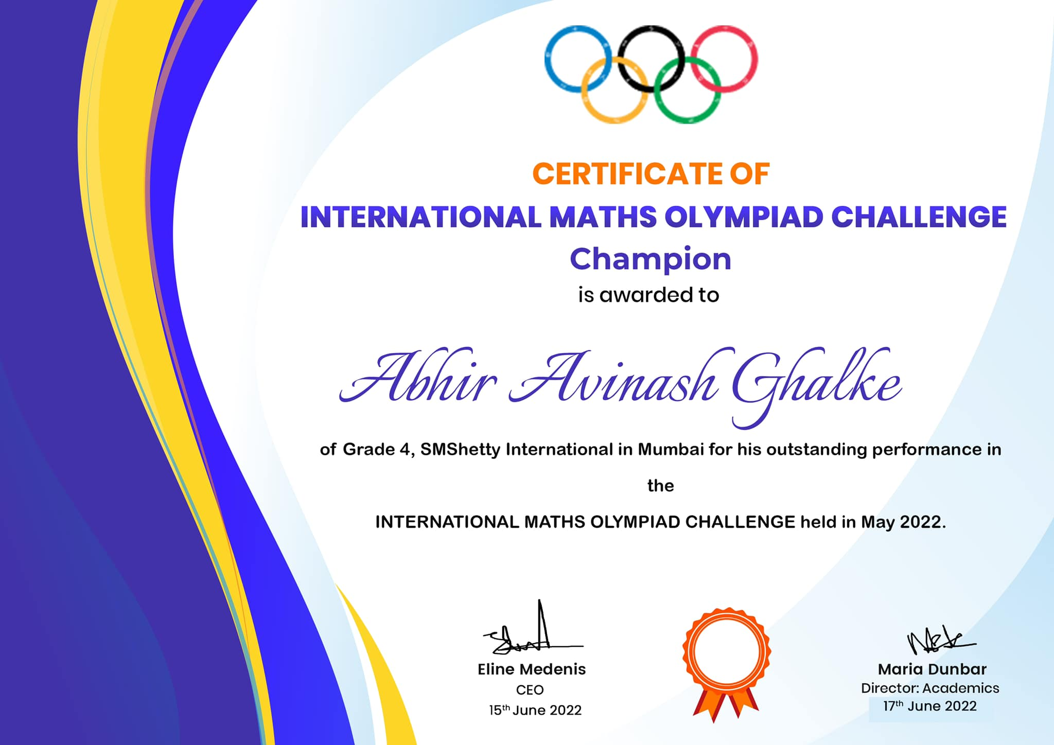
Abhir Ghalke of CP VA has been awarded the title of International Math Olympiad Champion 2022. An appreciation letter has been received from Mr. Erin Anderson, Director: Global Programs, International Math Olympiad Challenge, Orlando, Florida.

Slide 10
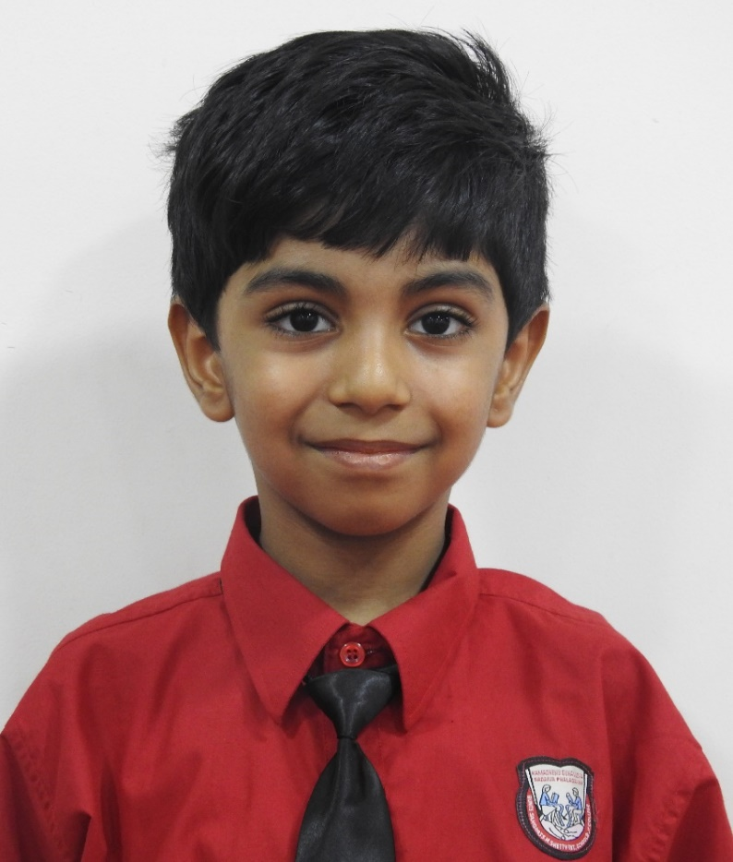
Saket Ananthakrishnan, Cambridge Primary IV - outstanding performers in Curious Times creative challenge 2022 - Performing arts category for his piano performance

Slide 11
School Champs for Climate Action 2021

Slide 12
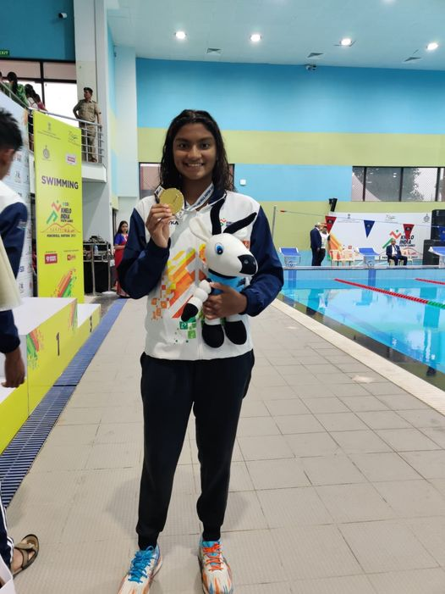
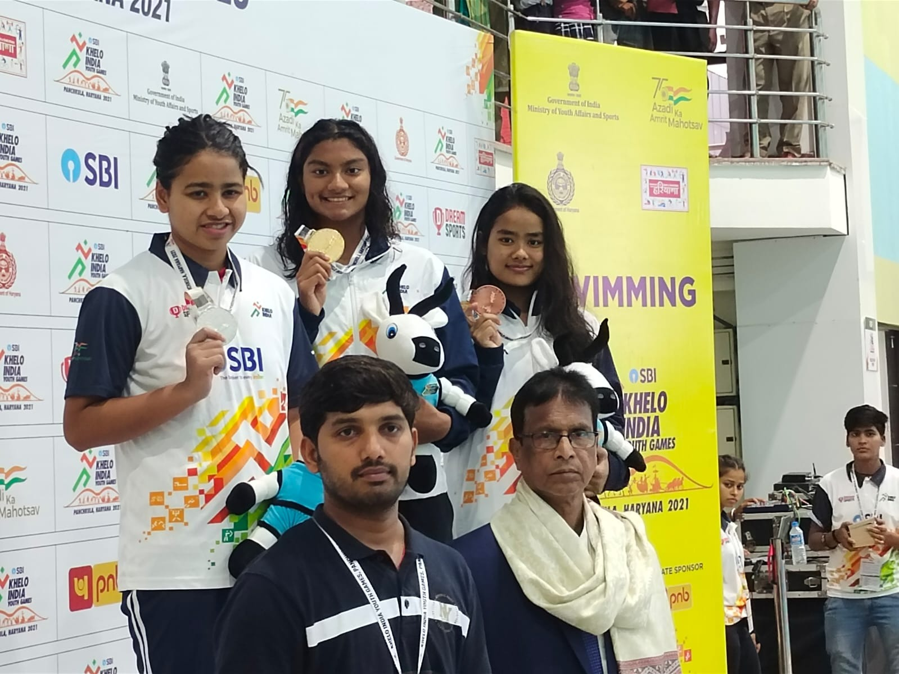
Apeksha Fernandes has won gold in the 100m Butterfly Stroke with a new record in Khelo India Youth Games 2021

Slide 13
ACHIEVEMENTS 2021-2022

Slide 14
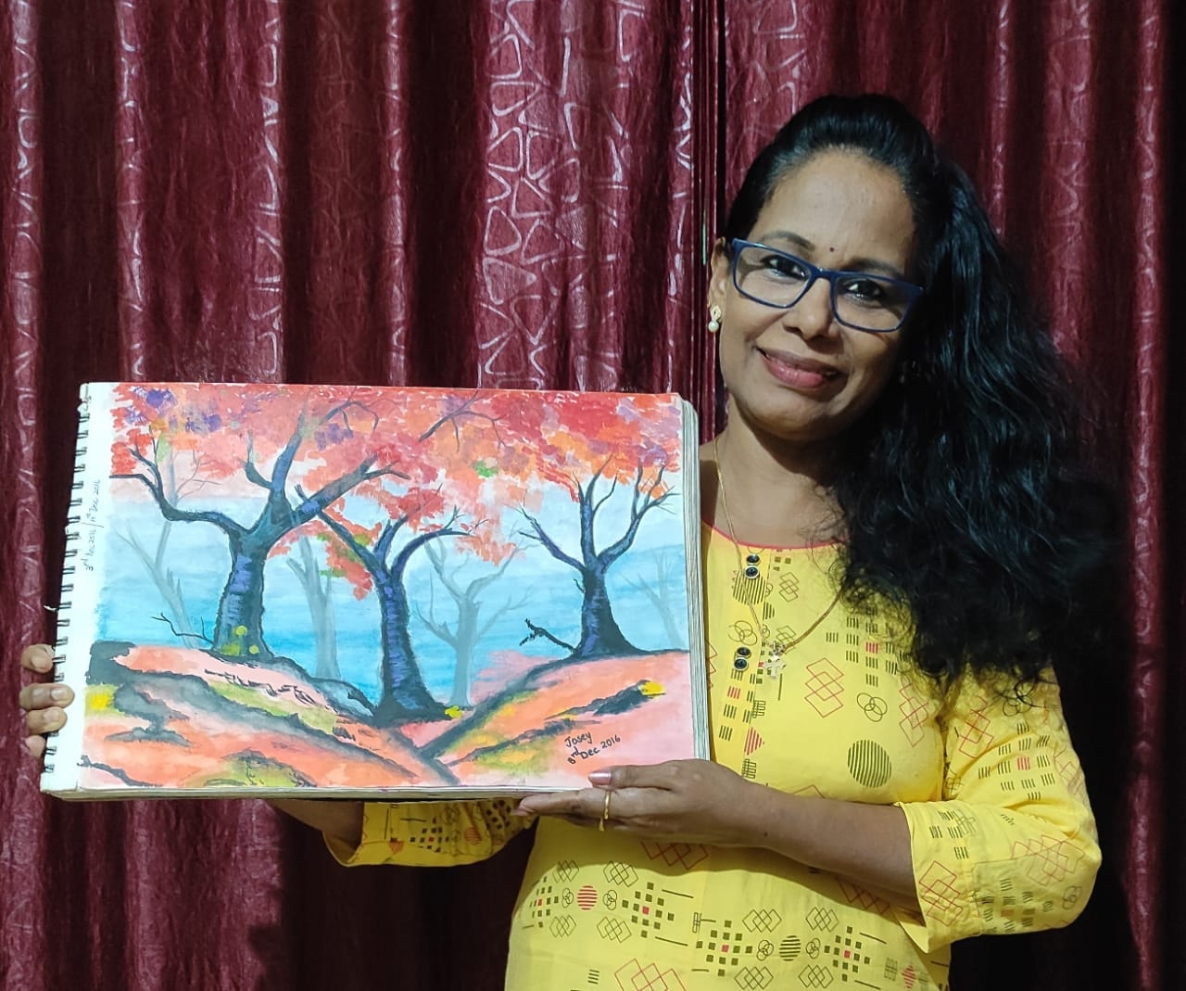

Painting of our Art Faculty, Ms. Josephine Davis has been showcased in PAINTATHON, biggest Virtual Exhibition, World Book of Records, London, UK.

Slide 15
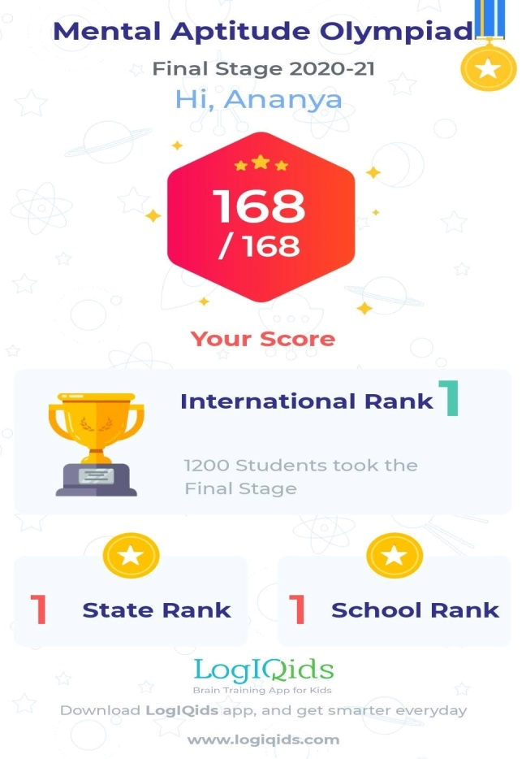
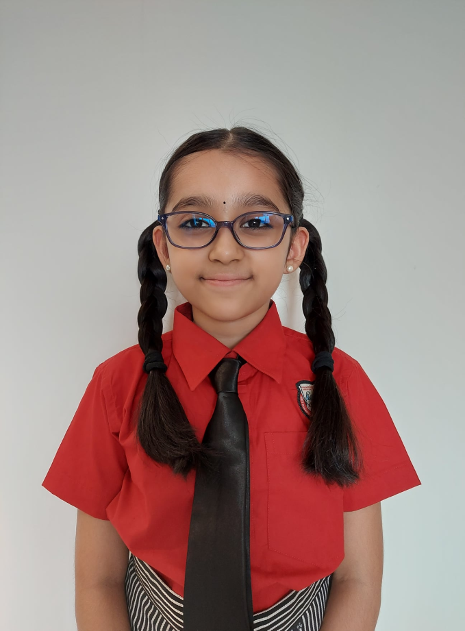
Ananya Harish from CP IV has secured first rank at the International, State and School Levels for the final stage of Logiqids Olympiad (2020-2021).

Slide 16
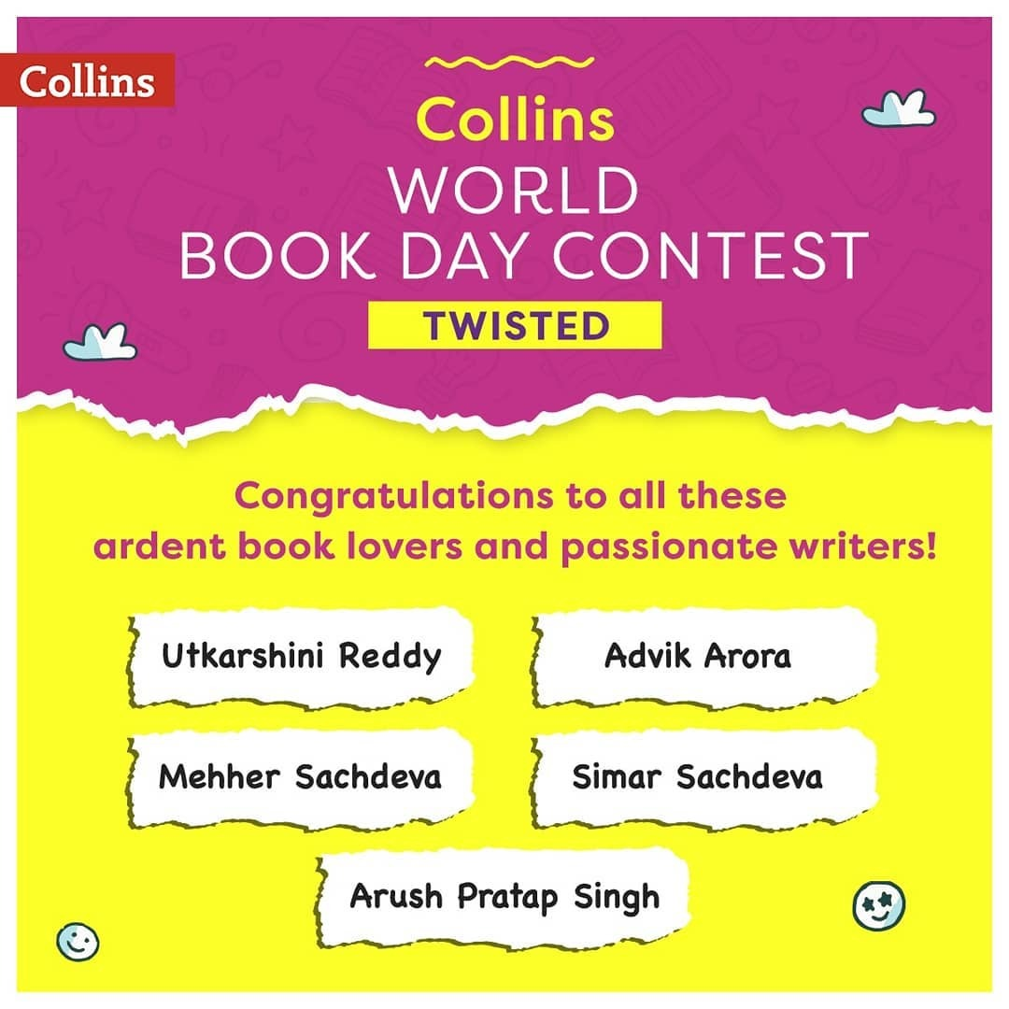
AS Level Student, Advik Arora demonstrated Literary talent and has been selected among top five winners for the Collin’s World Book Day Contest.

Slide 17
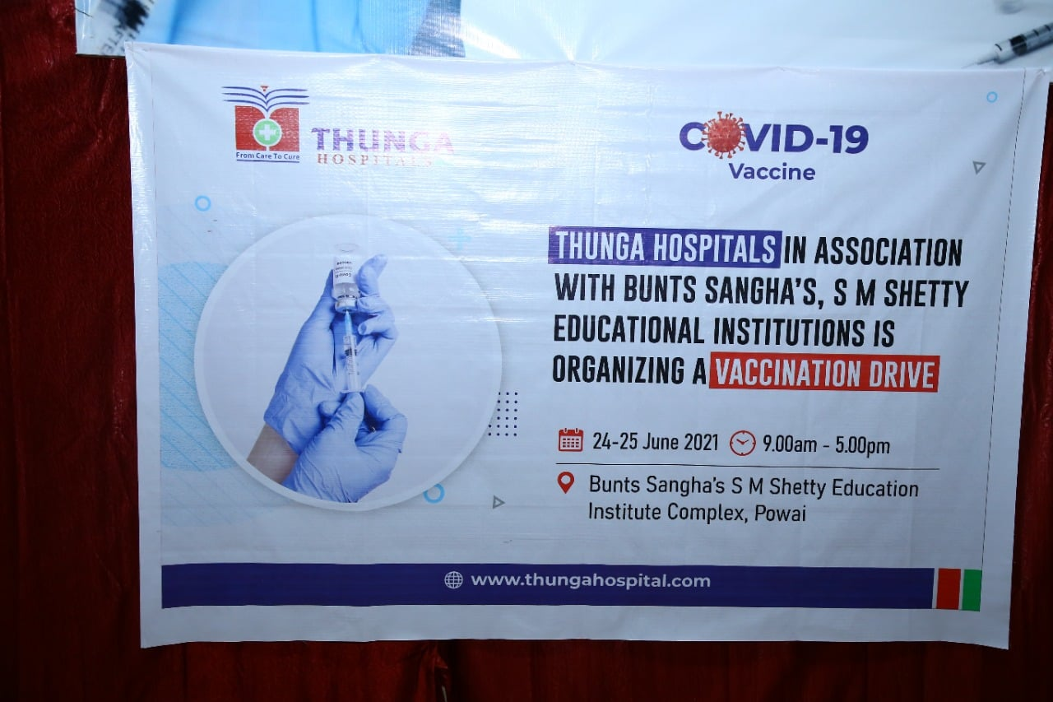
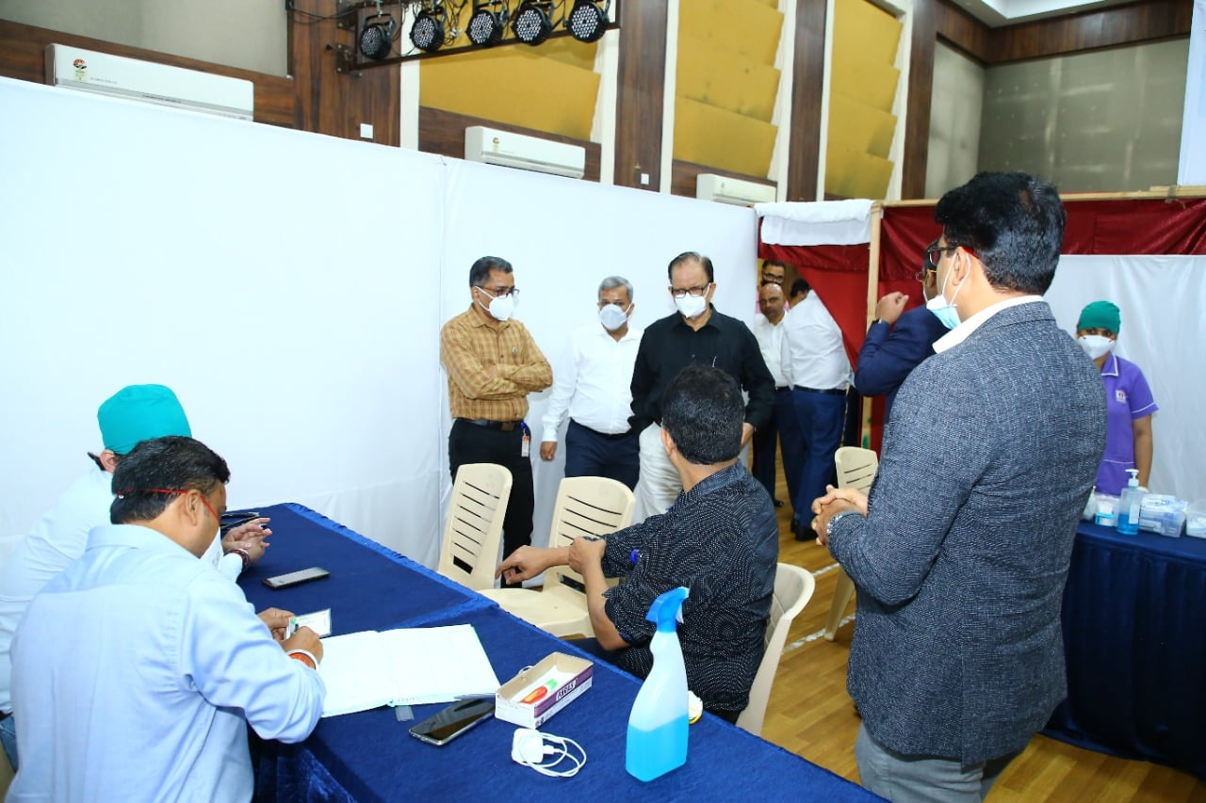
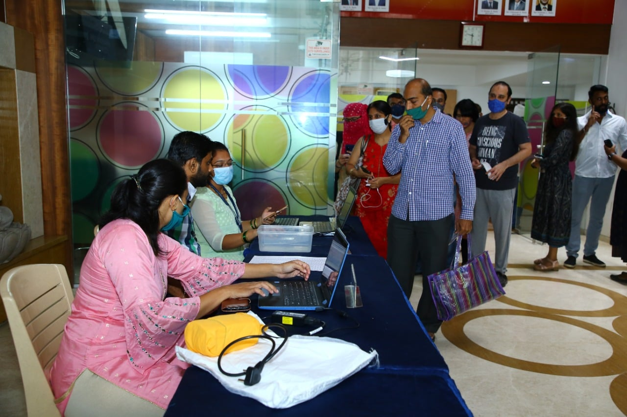
We thank our Management for organizing COVID – 19 Vaccination drive

Slide 18
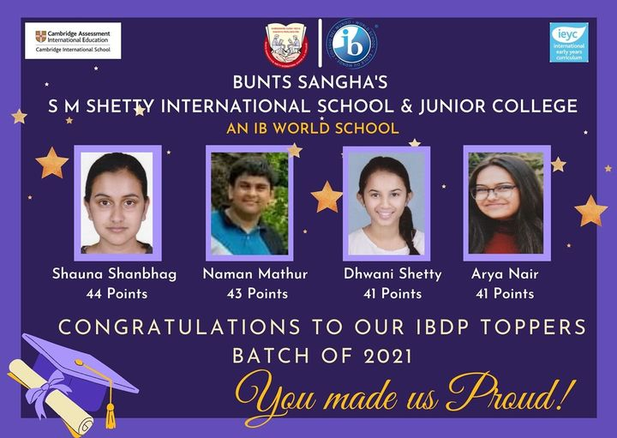

Slide 19


Shauna Shanbhag : 44 points
Naman Mathur : 43 points
Arya Nair : 41 points
Dhwani Shetty : 41 points
All these students are associated with our school from the primary years

Slide 20
Diploma | 2018 | 2019 | 2020 | 2021
Highest point achieved Highest % achieved | 30 69% | 32 76% | 40 89% | 44 --

Slide 21
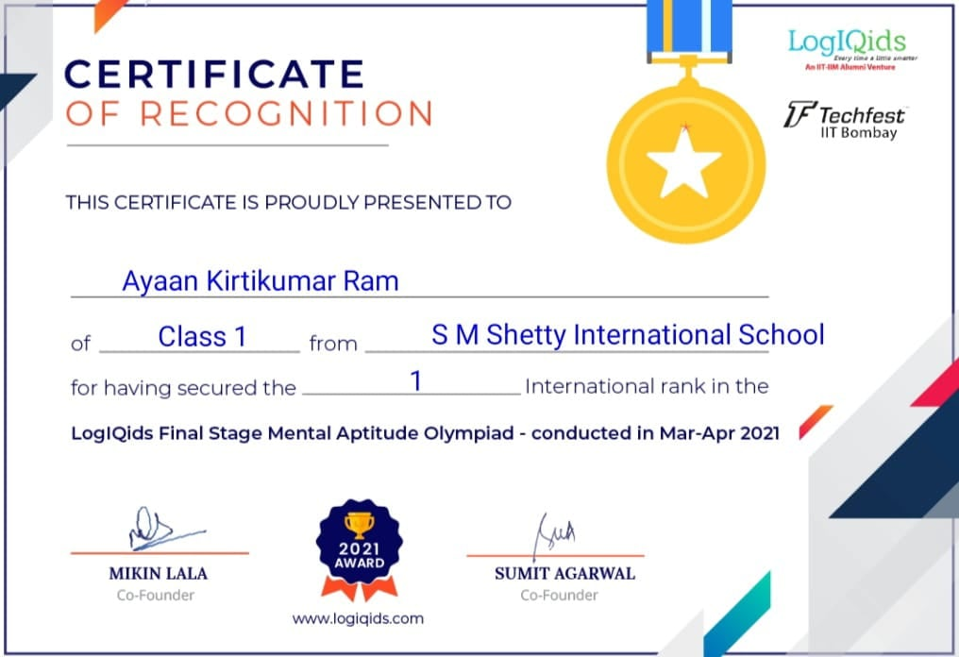
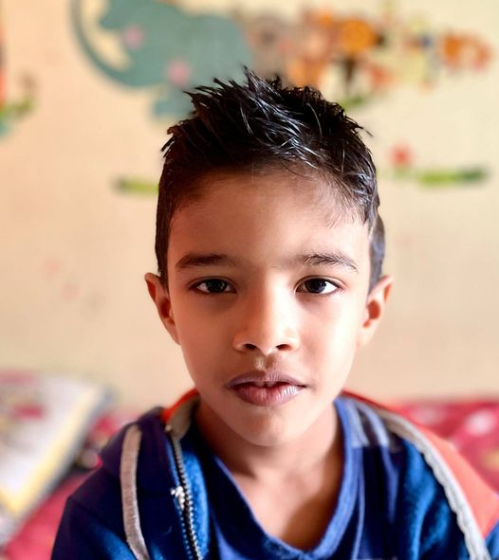
Ayaan Ram of CP II has secured International rank 1 in the LogiQids final stage Mental Aptitude Olympiad.

Slide 22
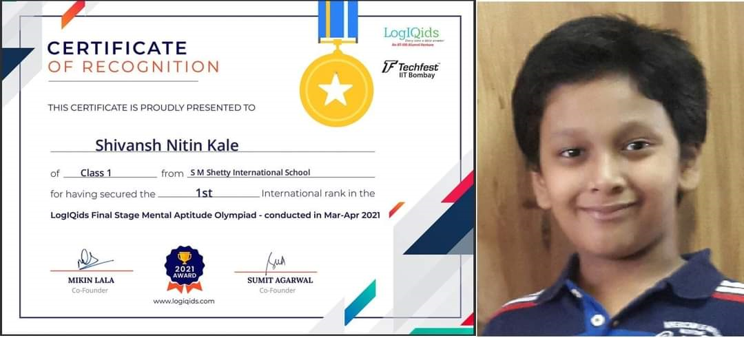
Shivansh Kale from CP II - C secured the International Rank 1, State Rank 1 and School Rank1 at the Logiqids Mental Aptitude Olympiad Final Stage 2020-21 held for CP I students during March- April 2021.

Slide 23
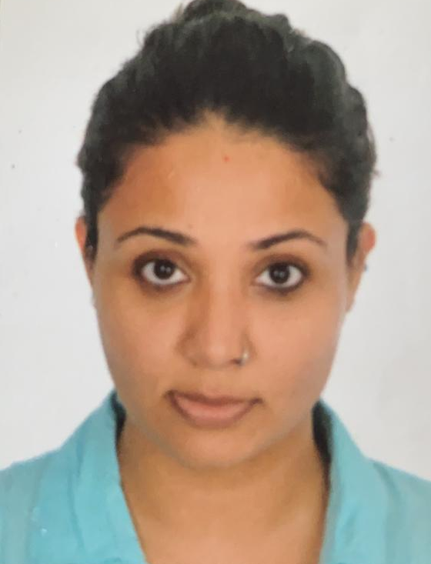
Our faculty, Ruchi Steven has been appointed as an IB examiner for Business Management

Slide 24
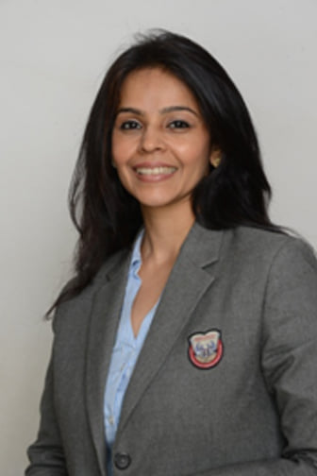
Our Primary Checkpoint Coordinator, Ms Neetha Shetty received the 'Award for Contribution to Student Development ' -Global Teaching Excellence Awards 2021.Global Teaching Excellence Awards - organized by Kites Kraft Productions identifies individuals & organizations working to revolutionize the education system.

Slide 25

Gulgun Satra,student of IBDP I student has been accepted to participate in the Take the World Forward Fellowship presented by Learn with Leaders in collaboration with Harvard College Project for Asian & International Relations (HPAIR), MIT Solv[ED], and the Leadership Institute at Harvard College (LIHC).

Slide 26
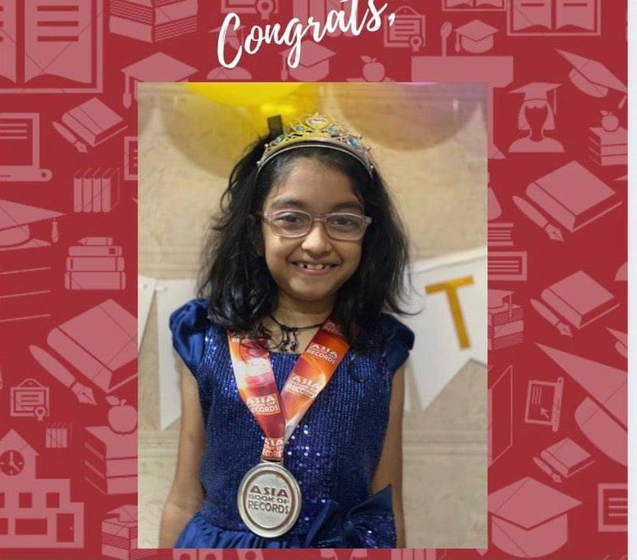
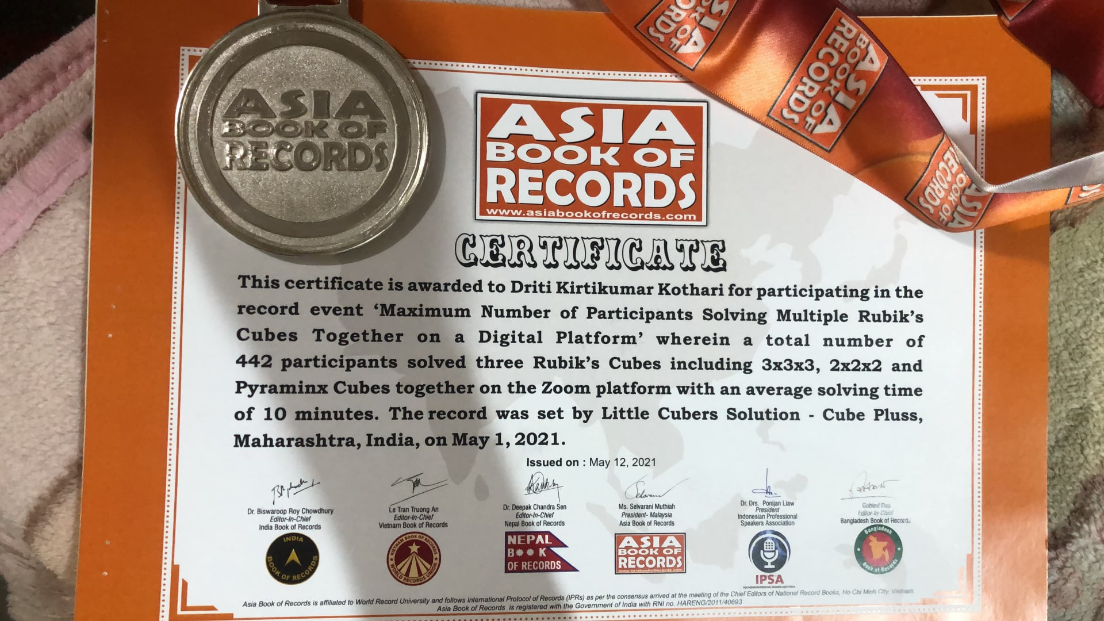
Driti Kothari of CP III holds a record in Asia Book of Records for participating in the event “ Maximum number of participants ( 442) solving multiple Rubik’s Cubes together on a virtual platform” The record was set by Little Cubers Solutions-Maharashtra

Slide 27
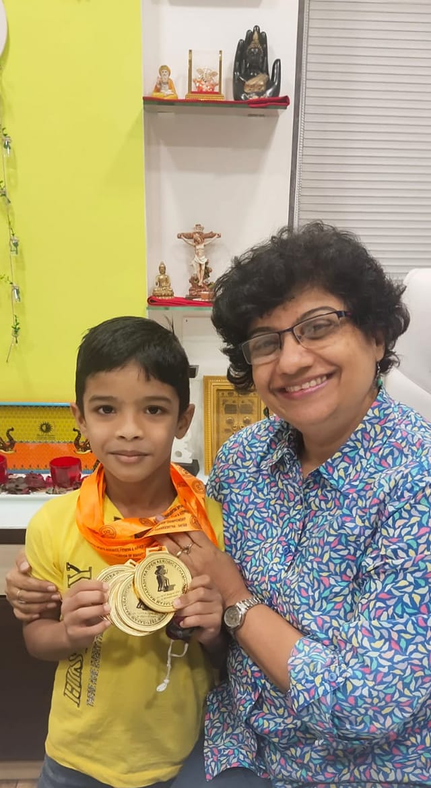
Ayaan Ram of CP II is the State Champion in Aerobics SAFAM Maharashtra Sports held at Kopargaon winning 5 Gold Medals in 5 events. His team Mumbai Suburns won the Championship with 76 gold, 8 silver and 1 bronze medals. Ayaan will represent Maharashtra at Nationals Level ISAFF India 2021.

Slide 28
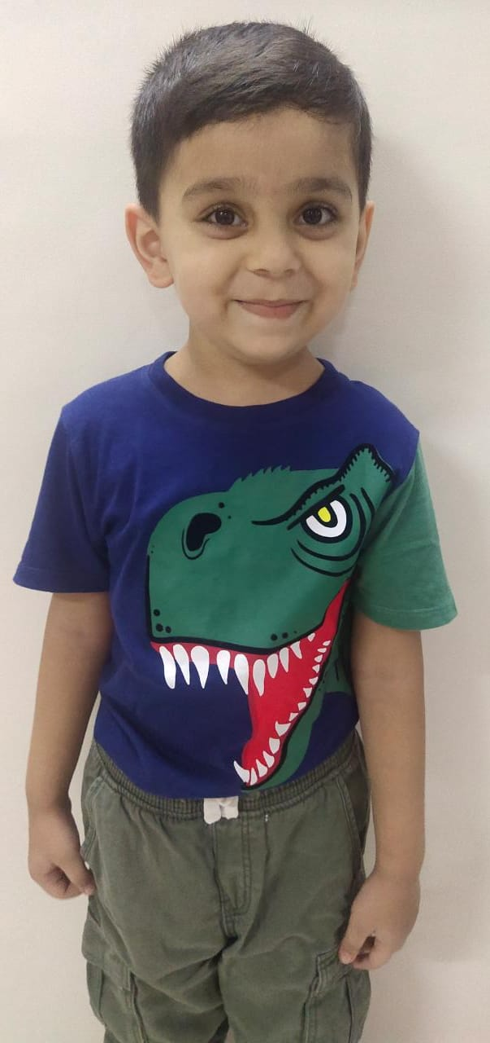
Kiaan Zaveri of IEYC II ranked 6th in the Mastermind National Level.

Slide 29
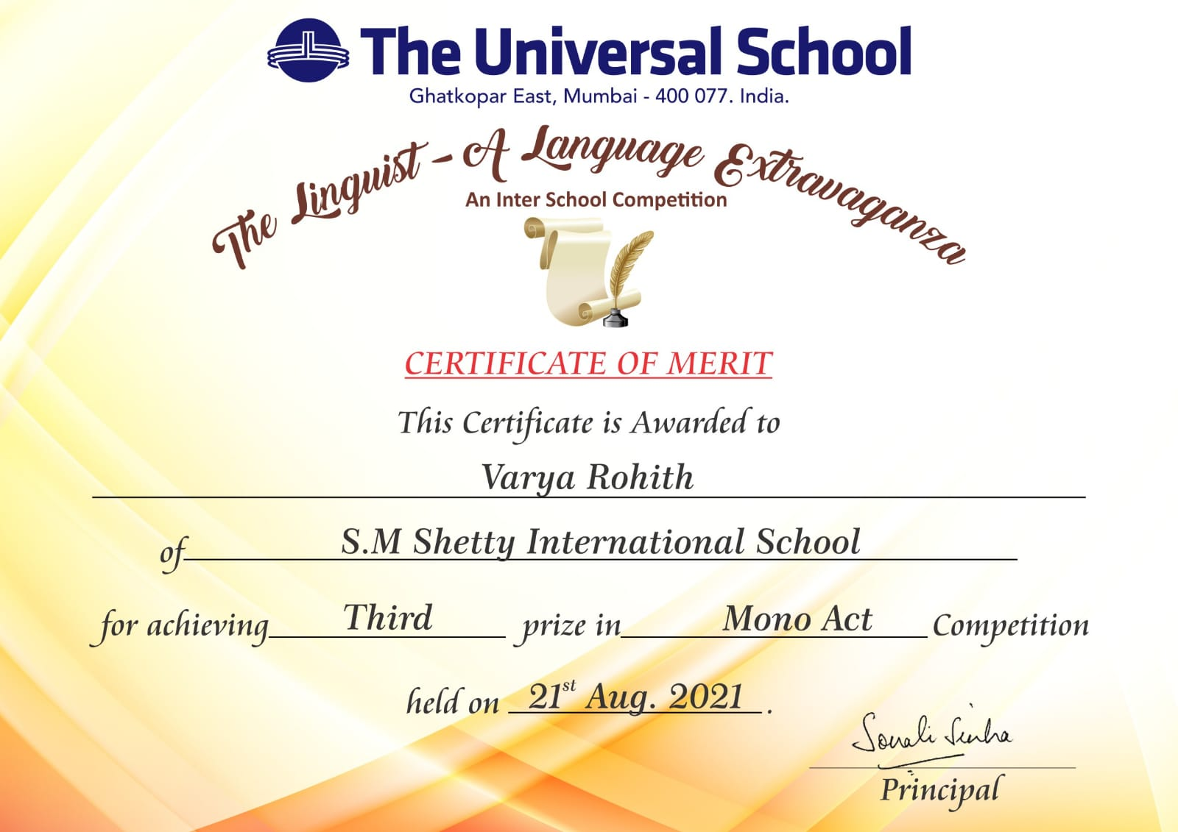
The Linguist-Universal School
Varya Rohith – Mono Act Competition

Slide 30
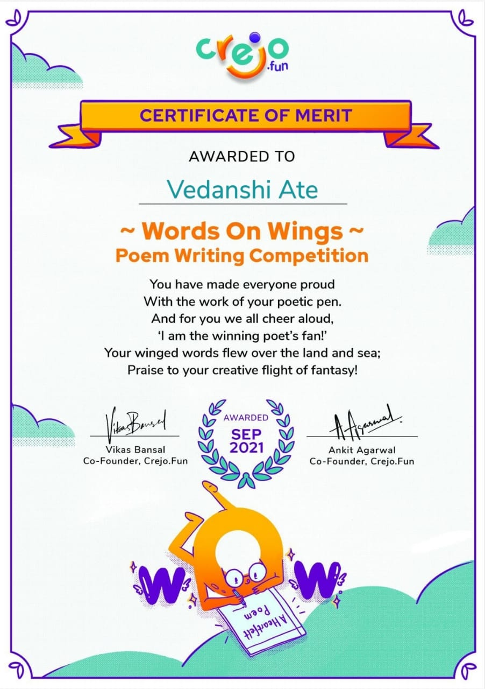

Slide 31
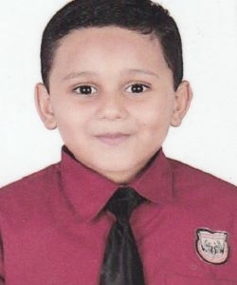
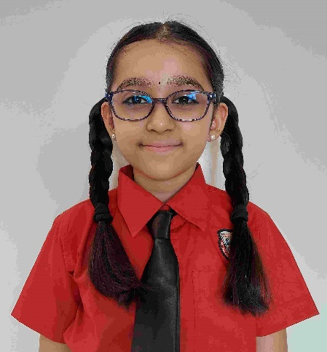
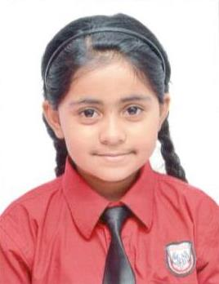
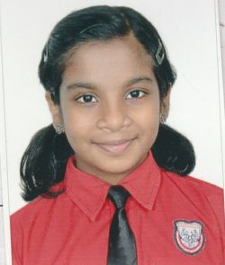
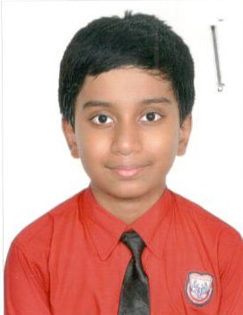
Winners of 3rd Inter-School Language Day hosted by Seven Isles International School

Slide 32
Curious Times
Four students were among the top 36 Winners pan India for the Innovative Young Citizen's Challenge organized by Curious Times
Yashas Das CP I
Aadit Parakh CP III
Ananya Harish CP V
Ethan Fernandes Checkpoint I

Slide 33
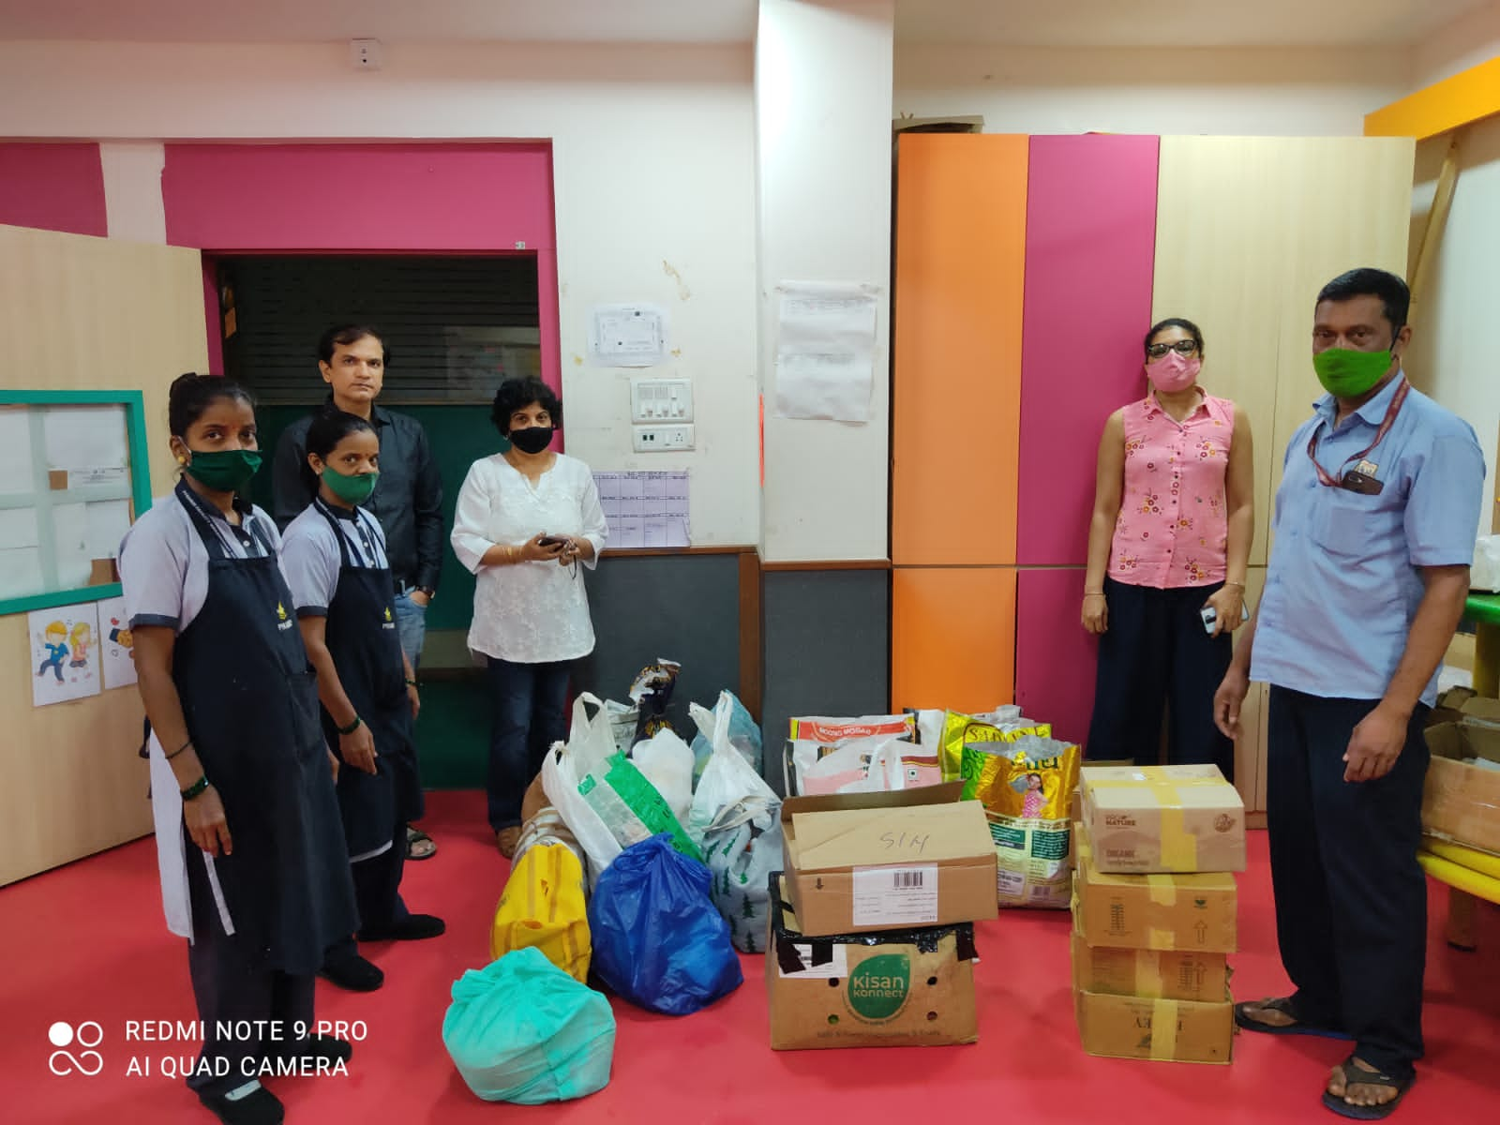
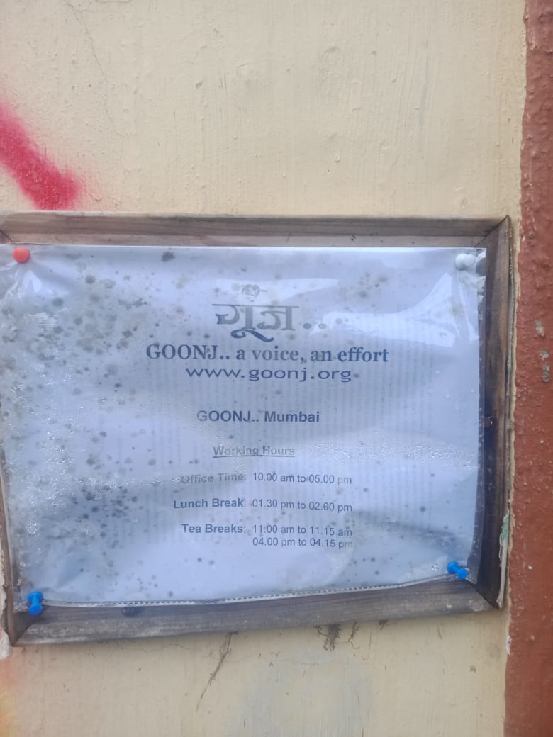
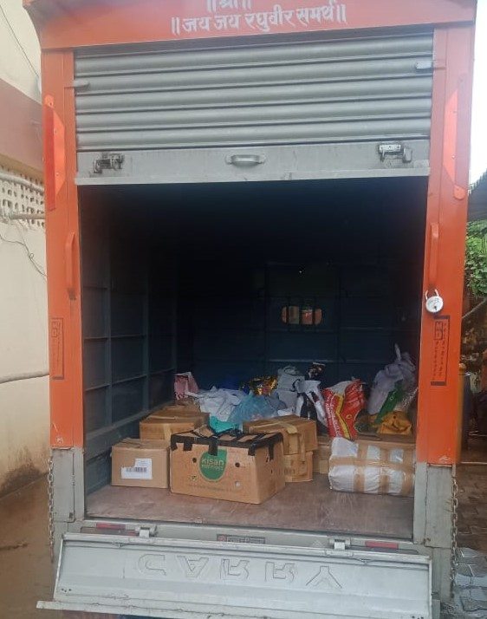
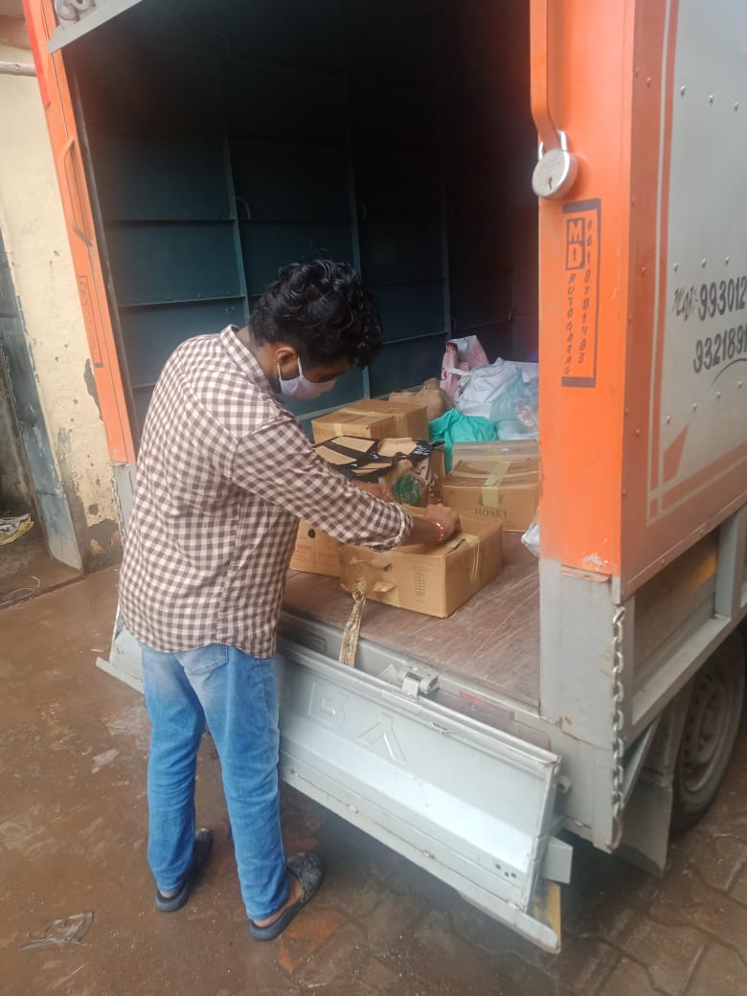
Konkan Relief

Slide 34
IB Five Year Programme Evaluation Report
Based on the findings included in the report, the IB has not identified any matters to be addressed. We trust the information found in this report will support the school in its continued implementation and enhancement of the IB programme.
We wish you continued success with the implementation of the IB Programme. We hope the self-study process has been beneficial and will lead to an even stronger programme implementation. We appreciate the contribution your school makes to the IB community and look forward even greater engagement in the coming years.
Yours sincerely,
Adrian Kearney
Director of IB World Schools

Slide 35
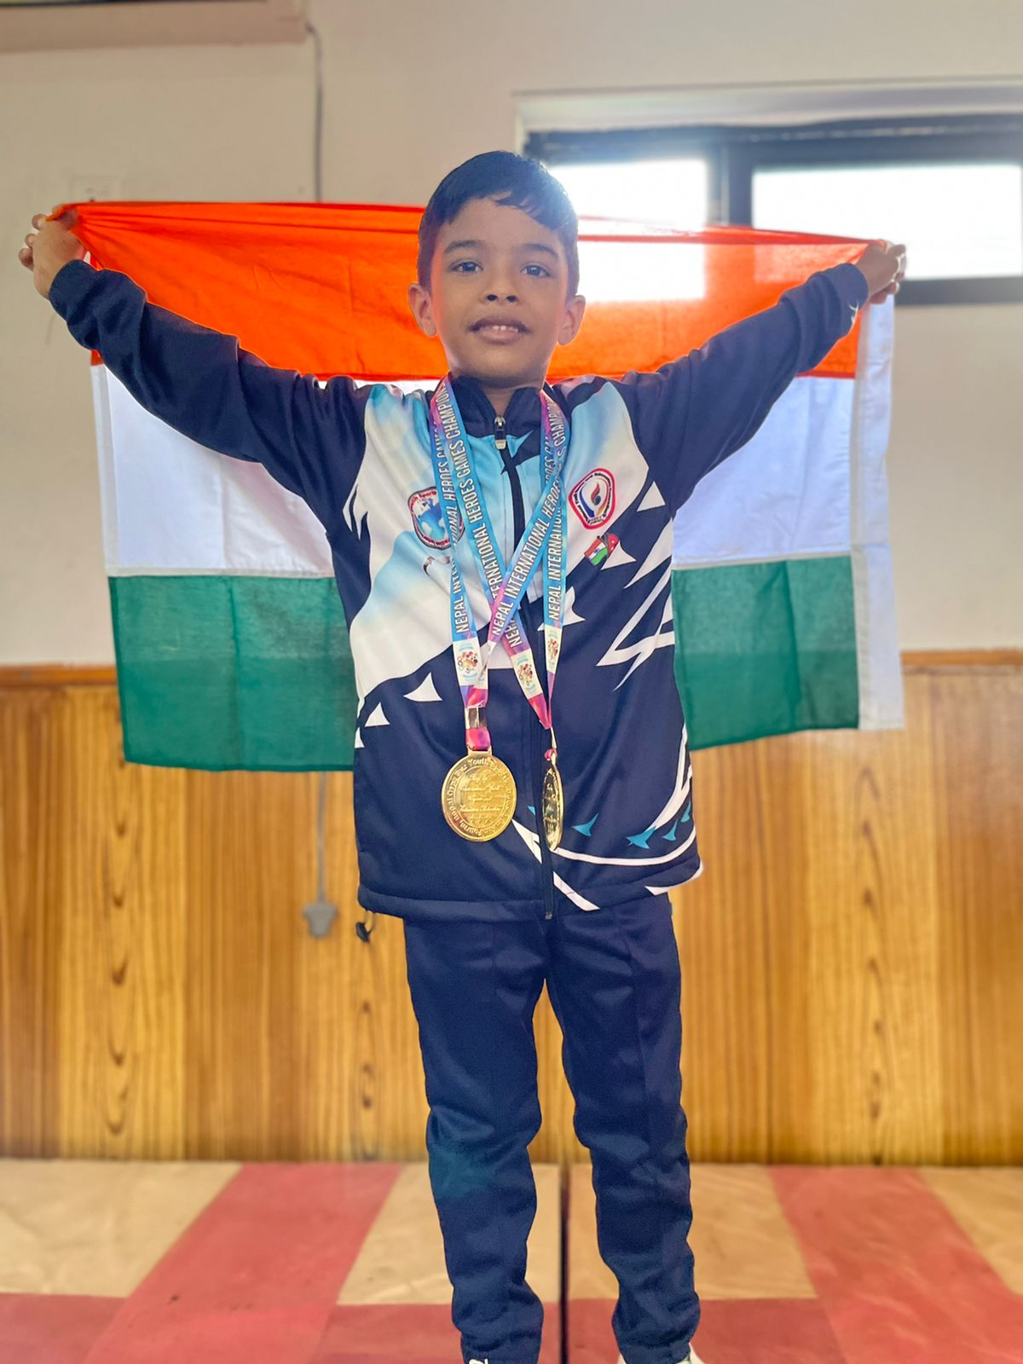
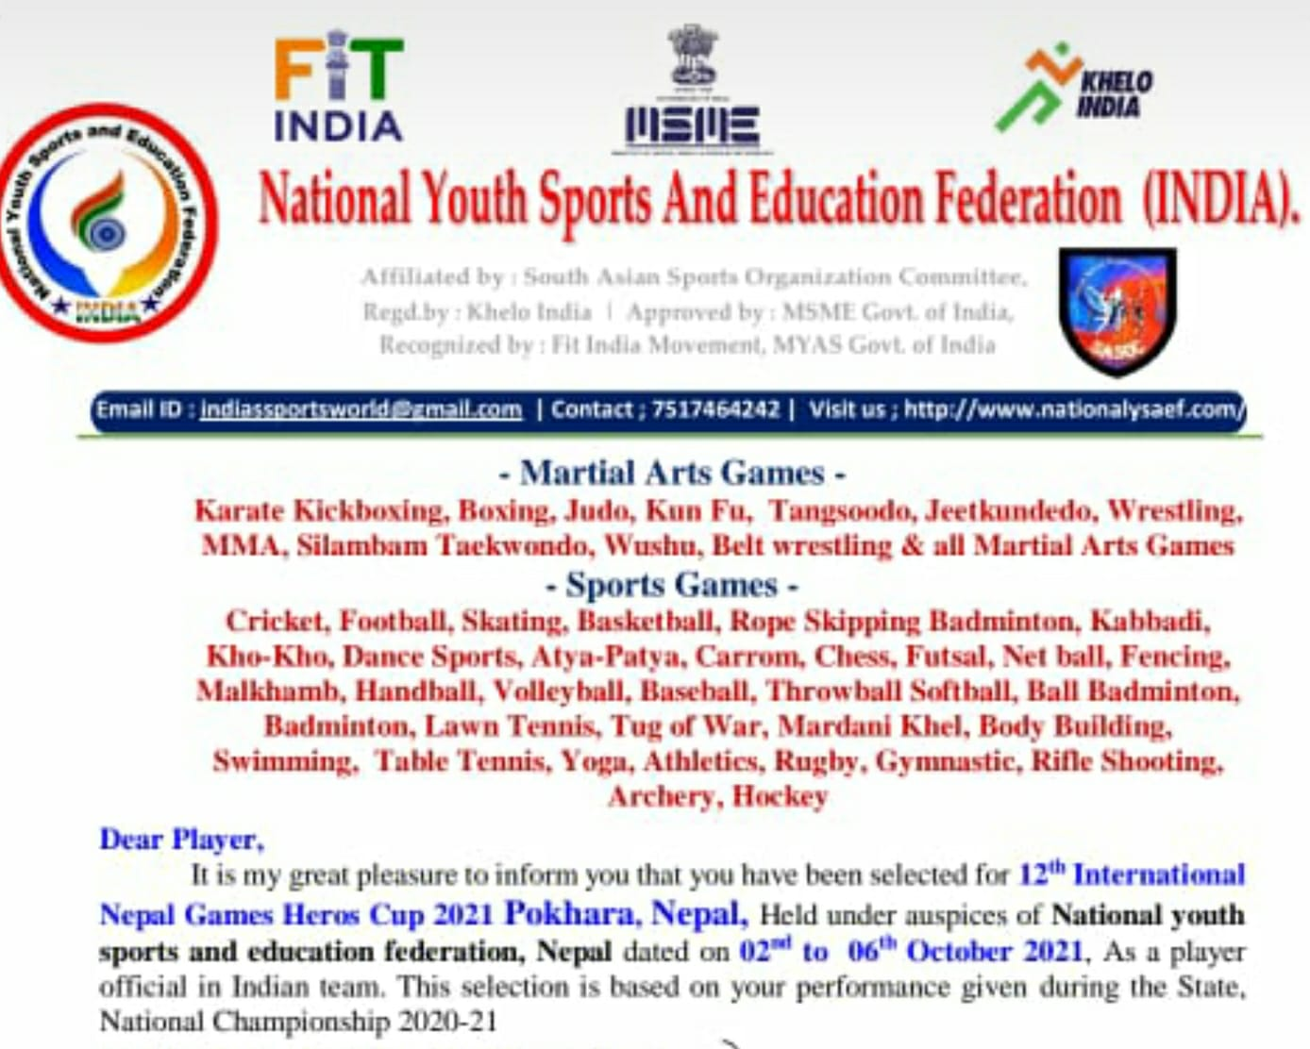
Ayaan Ram of CP II - 3 Gold Medals , Aerobics – Individual Gold – Aerobics Mix Pair and Rope Malkhamb conducted in Nepal orgainsed by National Youth Sports and Education federation (INDIA) from October 2 to October 6,2021

Slide 36
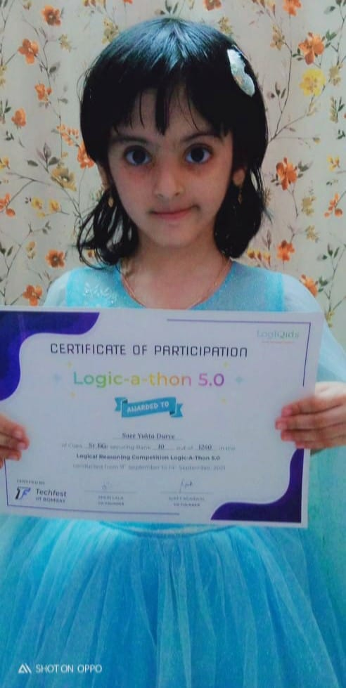
Saee Durve of IEYC III - Rank 10 in the Internationally held Logical Reasoning Competition Logic-A-Thon 5.0.

Slide 37
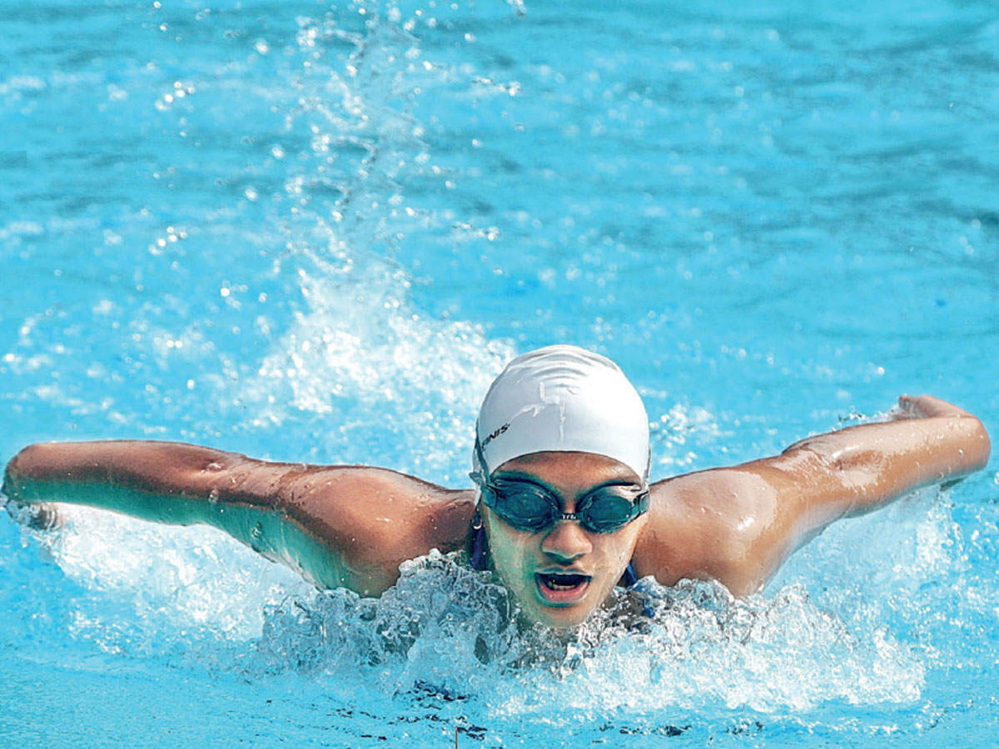
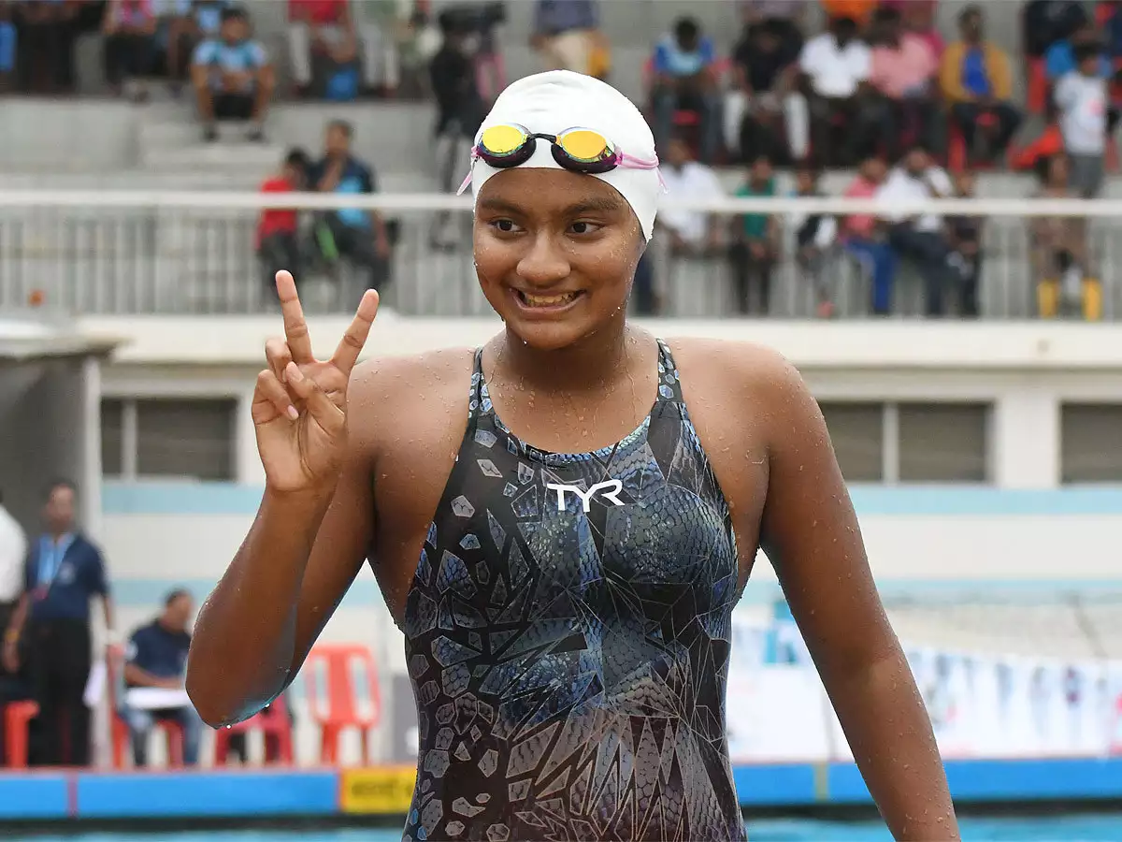
Apeksha Fernandes-AS Level represented Maharashtra at the National Aquatic Championship conducted by Swimming Federation of India at Senior and Junior Level in October

Slide 38
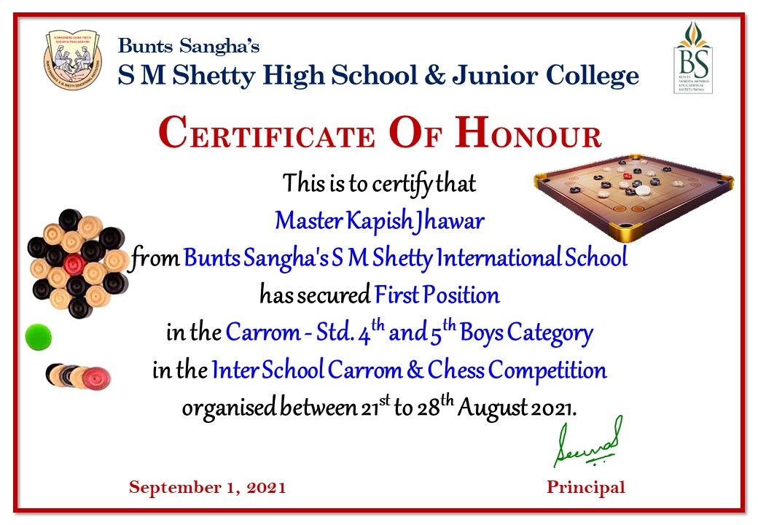
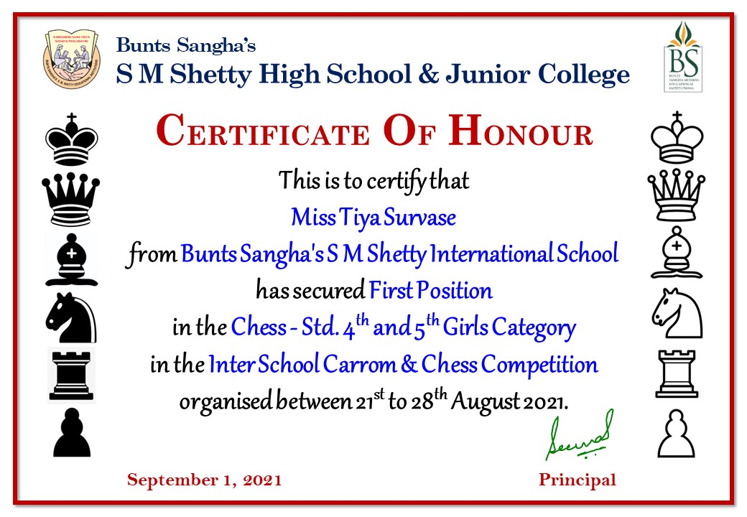

INTER SCHOOL CARROM AND CHESS COMPETITION

Slide 39
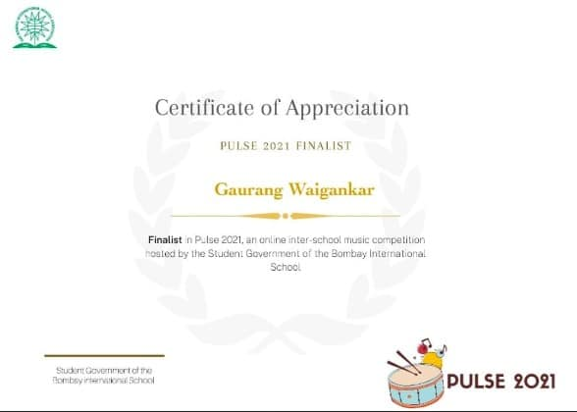

Gaurav Waigankar of Checkpoint-finalist for Pulse 2021 an online inter-school music competition organised by Bombay International School.

Slide 40



Principal,Ms Mildred Lobo was inducted as a member of the “Swiss Culture Committee” by organisation for Swiss Education

Slide 41


Our school has been recognized among the Top 20 Mumbai Schools offering the International curriculum and among the Top 5 Schools in Zone C in Time School Survey 2021.

Slide 42




Apeksha our student from the International Section wins both the Junior National & Women's Championship at the National Aquatic Championship held in Bangalore last two weeks . She wins 7 Gold & 4 Silver Medals . She created three National Records. She won the Best Swimmer in both the Junior & Women's Category with the highest medals. she has been adjudicated as the *best swimmer in the country at 16

Slide 43




Slide 44


Riddhima Pradhan from Checkpoint III secured First rank in Fitness Challenge event U-15 female category in Spartive Let’s Play! hosted by Pallavi Model School, Boduppai and Organized by SFAPLAY.COM.

Slide 45





Shanaya Poojari from IEYC I won 1st prize and Vian Mehra from IEYC I won the 2nd prize in Character Parade, Shivansh Kapse from IEYC II won 1st prize, Naisha Sharma from IEYC II won 2nd prize, Aaradhya Kumar from IEYC III won 3rd prize in design a Book Jacket. Arzoo Dhindsa from IEYC III won the 1st prize in the Book Review competition in RBK International Academy, Interschool Literacy Competition held on October 8, 2021.

Slide 46
We ranked No.1 in India under the Top International Schools – Parameter wise for ‘Co-Curricular Education’ in a survey conducted by
Education Today

Slide 47



We are extremely delighted and proud to inform you that Samvit Mavinkurve ,our student of A Level is a winner of the prestigious Cambridge Outstanding Learner Award in the category 'Top in the World' for AS Mathematics with a score of 125/125 at the March 2021.

Slide 48


On the occasion of Children's day, November 14, 2021, Ayaan Ram of CP II participated in District level Malkhambh competition and won gold with A+ certificate.

Slide 49


Our Sports faculty, Ms. Jennifer Coutinho participated in 2nd Maharashtra State Masters Games Championship 2021 held at Indrapur, Pune. She stood 1st in 100 and 200 mtr run in 35 plus women’s category. In women’s Football Championship she represented Thane district

Slide 50

Top School in International Curriculum of Time ICONS 2021

Slide 51
In the Education World School Rankings 2021-22, the school has ranked among the Top 50 International Schools across Mumbai and Maharashtra.

Slide 52

Fit India School Week 2021 and successfully completed all the activities as per the guidelines provided on the Fit India Website.

Slide 53

Ayaan Ram won gold in Aerobics at the 16th SAFAM Mahararashtra competition held in Nashik.

Slide 54


Our A level student Anurag Inamdar and IBDP student Pratham Dusad have been selected for a Harvard x MIT six months long fellowship where they will be working on research projects and pitching them to global innovators and investors.

Slide 55

Our AS Level, Samvit Mavinkurve successfully completed the NASA-Inspired Leadership Workshop by Learn with Leaders, in collaboration with Dr. Ed Rogers (Former Chief Knowledge Officer, NASA Goddard Space Flight Center) from 4th - 12th December 2021

Slide 56

Ms Jennifer Coutinho, our Sports Faculty has been selected for Asian Football Confederation C license Diploma course for coaches. The All India Football Federation has a women’s edition and only 20 women coaches have been selected pan India.

Slide 57

IEYC section of SMSISJC is ranked 4th in Times Pre-school survey 2022 under K-12 Schools, International Curriculum category.

Slide 58


Soumya Pandey won bronze medal at Infinity Math Competition held on January 21,2022

Slide 59
Results of SOF International General Knowledge Olympiad ,2021-2022
Number of Students Participated: 49
Number of Students achieved Certificate of Distinction: 01
Number of Students achieved Gold Medal – 08

Slide 60
Sr. No. | Name of the Students | Class | Certificates
1 | DRITI KOTHARI | CP III B | Medal of Distinction
2 | DAKSH SHETTY | CP IV B | Gold Medal
3 | PRATHAM RAO | CP II C | Gold Medal
4 | SUNAINA BARAL | CP II C | Gold Medal
5 | AISHANI CHATTERJEE | CP III A | Gold Medal
6 | ARCHIT MANOJ PANDA | CP IV B | Gold Medal
7 | ARNAV PATHARE | CP IV D | Gold Medal
8 | AINDRI OMAR | CP IV D | Gold Medal
9 | SOUMYA SATYENDRA UPADHYAY | CP V C | Gold Medal

Slide 61


PE Faculty, Jennifer Coutinho has been selected by Mumbai Football Association First Women's Committee in Women's Development for a term of 4 years

Slide 62
Silver Zone International Olympiads
Subject | Award
English | 1Gold Medal 1 Silver Medal
General Knowledge | 1 Silver Medal
Informatics | 1 Gold Medal of Excellence 1 Silver Medal

Slide 63

Sanvi Gaikwad secured the third position in the Global Platter competition of Late Shri V V Bhat memorial trophy competition organized by Children's Academy.

Slide 64
School has won the prestigious IMC Ramkrishna Bajaj National Quality Performance Excellence Award 2021 cycle in the Education Category. The selection for recognitions was done at the IMC Quality Improvement and Technology Committee (QITC) meeting held on 25th March 2022.

Slide 65


Tannishtha Shetty from IGCSE-I was selected among hundreds of applicants to attend an exclusive virtual Coffee with Leaders session with Dr. Edward A. Nardell, Professor of Medicine, Harvard Medical School.

Slide 66
Ayaan Ram from CP II B won 1 Gold, 1 Silver in Brihanmumbai District Gymnastic Competition 2021-2022.

Slide 67

Apeksha Fernandes of AS Level has been selected by School Games Federation of India for participation in ISF World School Gymnasiade 2022 to be held in Normandy, France.

Slide 68

Ananya Harish, has secured 1st rank Internationally at this year's National Science Olympiad, with a score of 60/60.

Slide 69

School was awarded the very prestigious Ramkrishna Bajaj National Quality Award 2021 Cycle in the Education on 30th April 2022 in a solemn and awe inspiring ceremony at the Indian Merchant Chambers .

Slide 70




Slide 71



Ayaan Ram participated in 16th ISAFF India National Aerobic Championship 2022 held at Sanjivani International School in Shirdi from 6th to 8th May.
Ayaan participated in 4 events and won 4 Gold medals

Slide 72

Master Vivikth Vedantam of IEYC III, who has secured the first position in the "Rapid Chess Championship" competition held by SMCA at JBCN International school on 8th May 2022.

