Slide 1
ACHIEVEMENTS
2020-2021

Slide 2
Our School has been ranked 4th in the “TIMES Preschool Survey (IEYC)- Mumbai 2020”

Slide 3
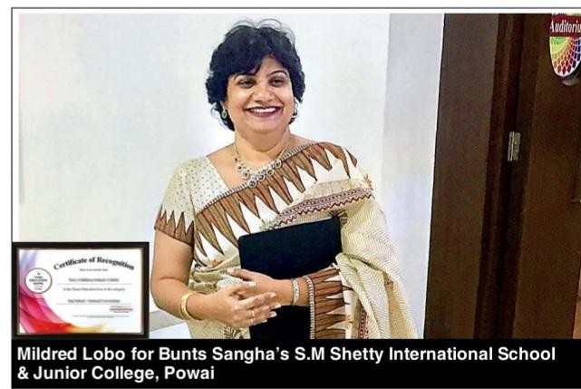
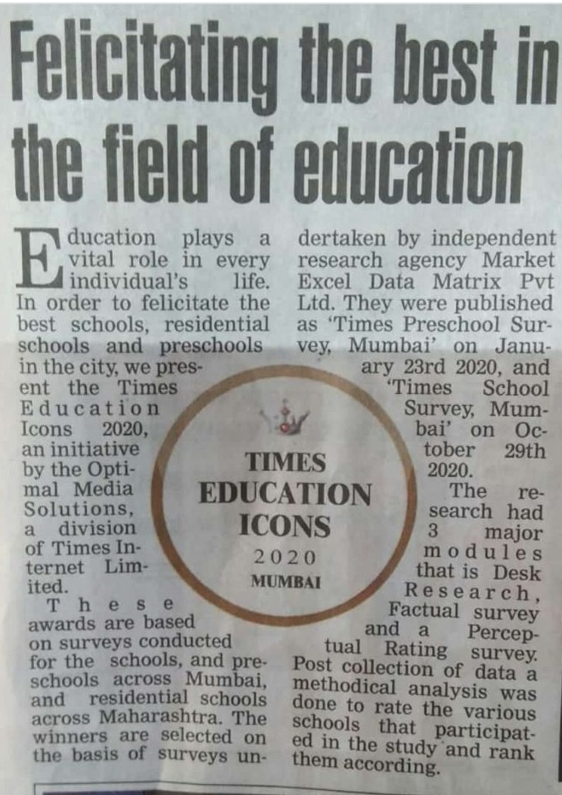
Ranked among the top 5 schools in Zone C offering International Curriculum by Times School Survey 2020.

Slide 4
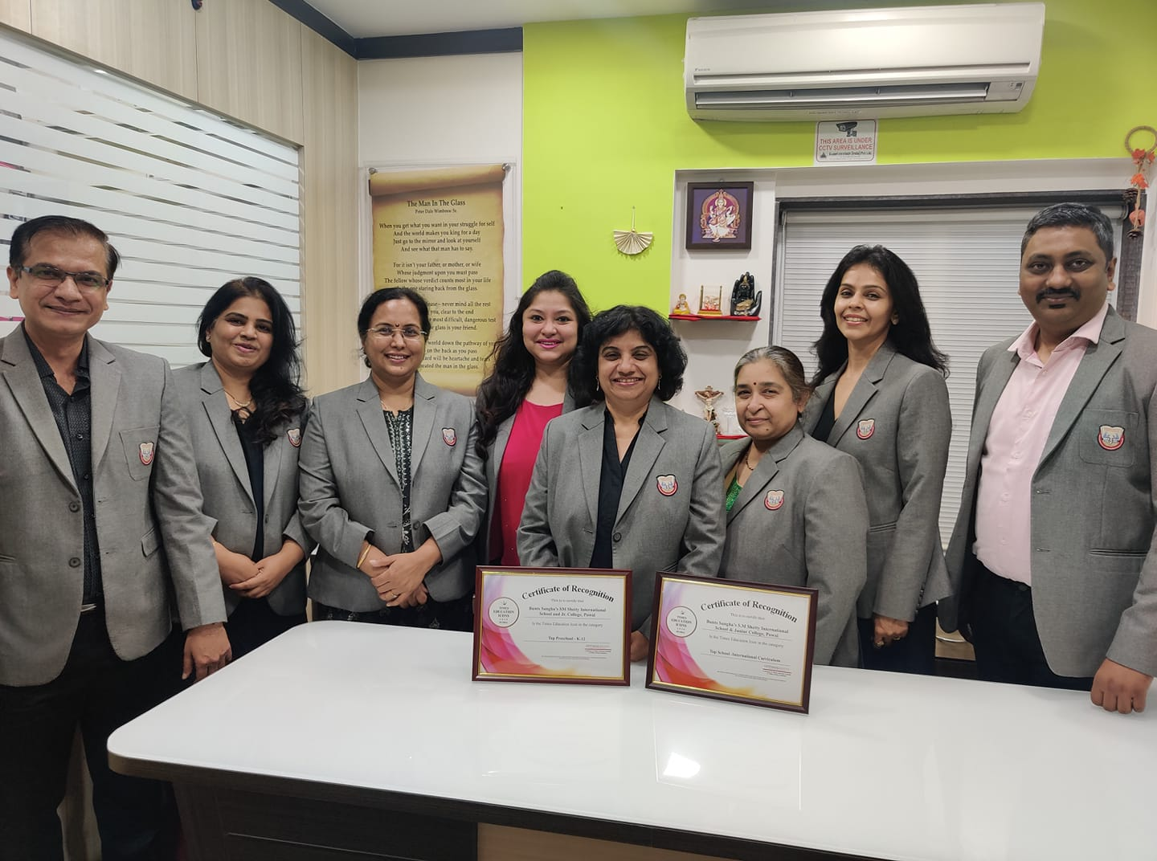
Times Education Icon 2020 Top School – International Curriculum and Top Preschool- K-12

Slide 5
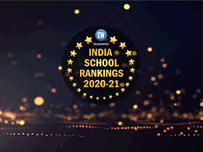
Ranked 34th in India in the Category of International Schools by Educational World- 14th annual Education World India School Rankings survey 2020.

Slide 6
Principal was conferred Best District Principal Award 2019-2020 by Science Foundation Olympiad (SOF) for outstanding results of students in Olympiad examinations

Slide 7
Principal Ms. Mildred Lobo was conferred Best District Principal Award 2019-2020 by Science Foundation Olympiad (SOF)

Slide 8
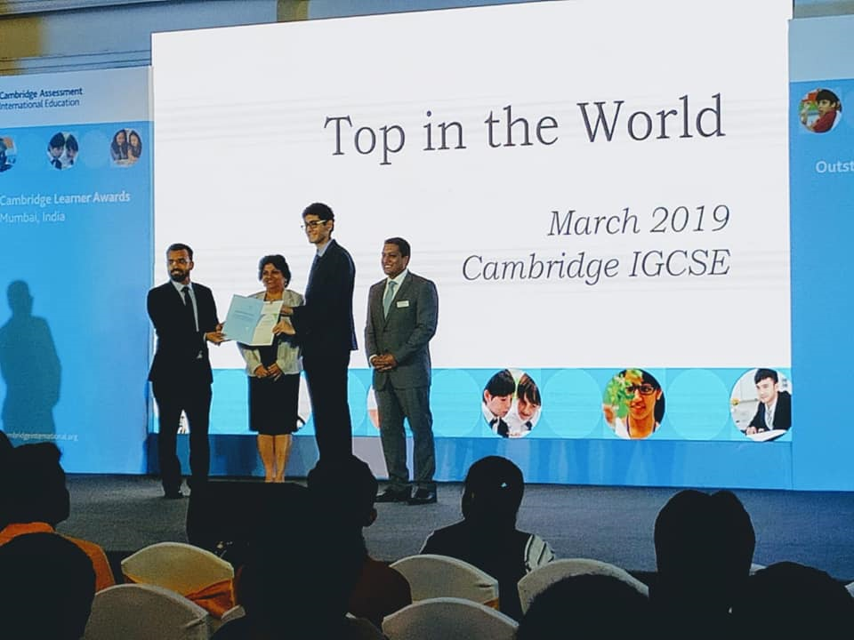
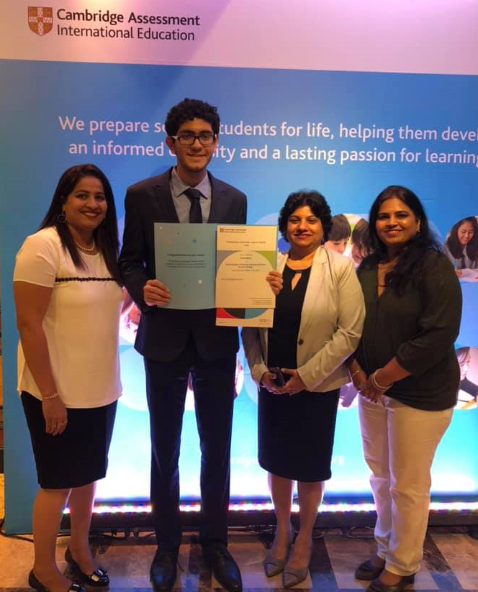
Rachit Mehta of IGCSE has secured Cambridge 'Top in the World' Award for securing 100/100 in Mathematics at the IGCSE March 2019 examination. He was felicitated at Cambridge Learner’s Award Ceremony on 1st February 2020.

Slide 9
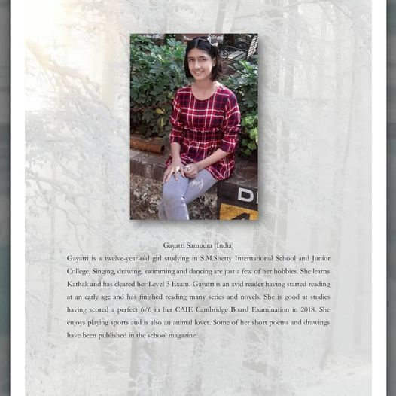
Gayatri Samudra - Checkpoint II Her Poem ‘The Firefly’ Published In Innsaei-international Journal Of Creative Literature For Peace And Humanity .

Slide 10
Gayatri Samudra - Checkpoint II Her poem ‘The Firefly’ has been published in INNSAEI-International Journal of Creative Literature for Peace and Humanity .

Slide 11
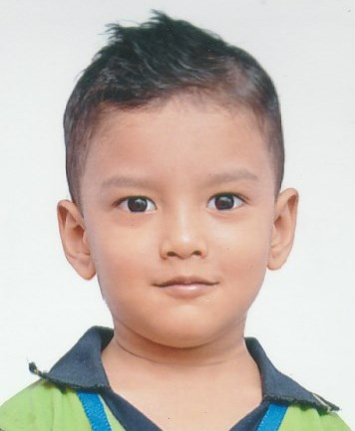
Swarit Dahake - IEYC II
2nd rank at National Level in Interschool Marrs Play to Learn Championship

Slide 12
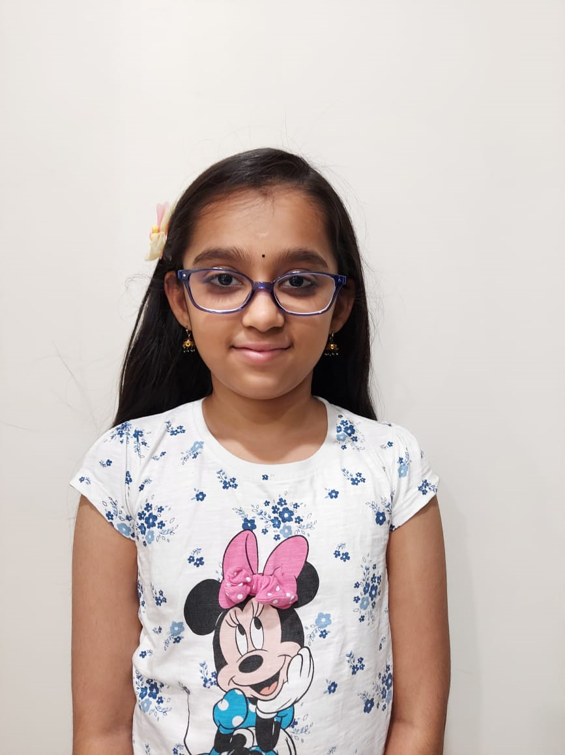
Ananya Harish - CP IV 9th Rank At International Level In Logiqids Mental Aptitude Olympiad

Slide 13
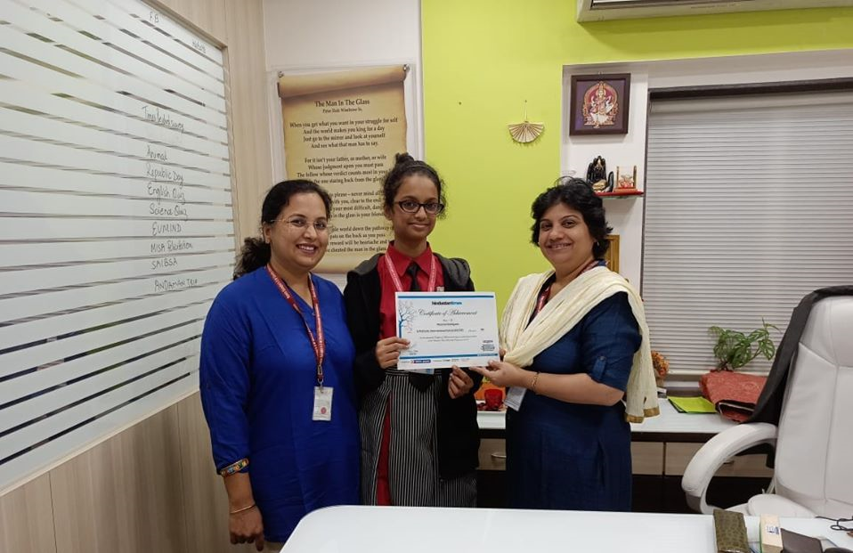
Melanie Rodrigues from Checkpoint II has been awarded the Certificate of Achievement for being one of the finalists shortlisted for the Hindustan Times Scholarship Programme 2019.

Slide 14
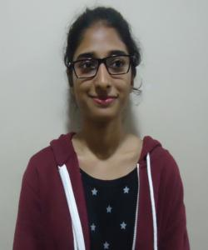
Ms Ifrah Choudhary, received the Cambridge Outstanding Learner Award in the category High Achievement for History at AS level in the Cambridge November 2019 series.

Slide 15
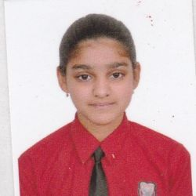
Ms. Kiranmayee Lade of Checkpoint II participated in a Focus Group Workshop (Young Women in STEM Mentoring Program) in collaboration with Harvard Graduate Women in Science & Engineering (HGWISE).

Slide 16
Priyam Chheda, of CP 3 bagged the first prize in the MISA Inter school skating competition.

Slide 17
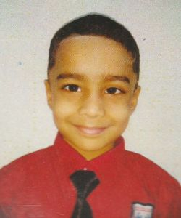
INTERNATIONAL ENGLISH OLYMPIAD RANKS
ANANYA HARISH
40/40
ABHIR GHALKE
39/40

Slide 18
LOGIQIDS MENTAL APTITUDE OLYMPIAD 2020-2021

Slide 19
INTERNATIONAL ENGLISH OLYMPIAD RANKS
97 students participated in International Olympiad organized by Science Olympiad Foundation.
13 students were awarded Gold Medal of Excellence .
2 students were awarded Medal of Distinction.

Slide 20
Sagarika Gupta from CHECKPOINT I C bagged Third prize in National Science Day Quiz 2021. THIS COMPETITION WAS ORGANIZED BY NEHRU SCIENCE CENTRE IN ASSOCIATION WITH MINISTRY OF CULTURE , GOVERNMENT OF INDIA

Slide 21
Students of Cambridge Primary Grade IV bagged the prize for Best Overall Presentation at MISA SYNERGY 2020-21, an Interschool Science Educational event for Cambridge Schools.

Slide 22
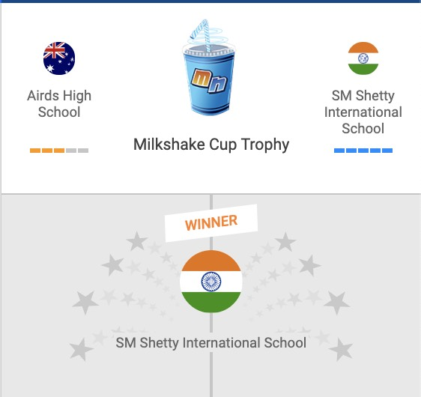
Our School has won the Fai-to (International Competition) against Airds High School, Australia in Mangahigh Mathematics COMPETITION

Slide 23
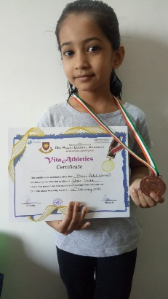
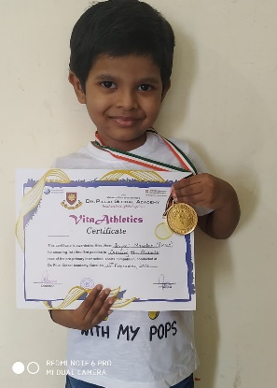
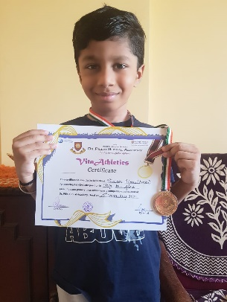
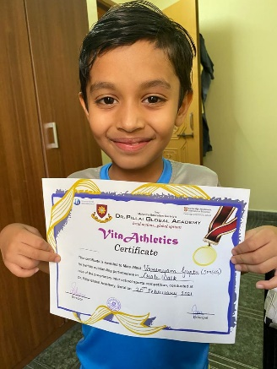
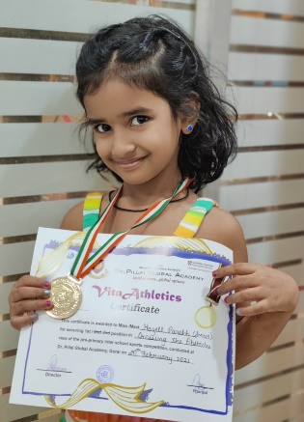
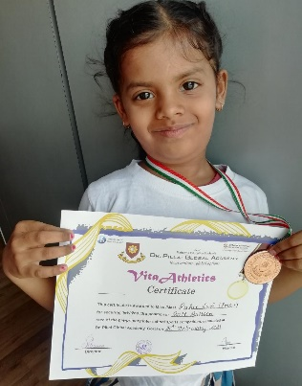
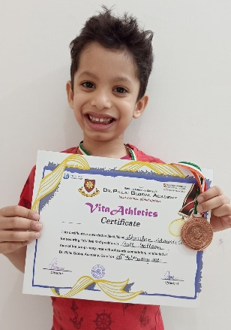
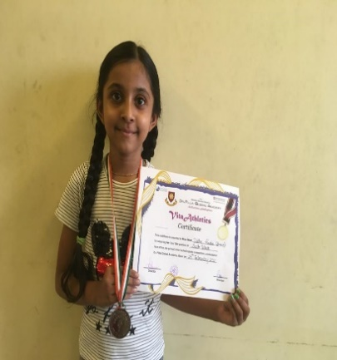
students from IEYC III participated and emerged as winners in VITA Athletics- Pre- Primary Interschool Competition conducted by Dr. Pillai Global Academy, Borivali, Mumbai.

Slide 24
Samvit Manikurve, AS Level secured first position in American Mathematics Competition

Slide 25
MANGAHIGH MATHEMATICS- ‘DIWALI MATH CHALLENGE 2020’

Slide 26
YOUNG MUSICIANS COMPETITION & AWARDS – QUARANTUNES BY MISA, 2020

Slide 27
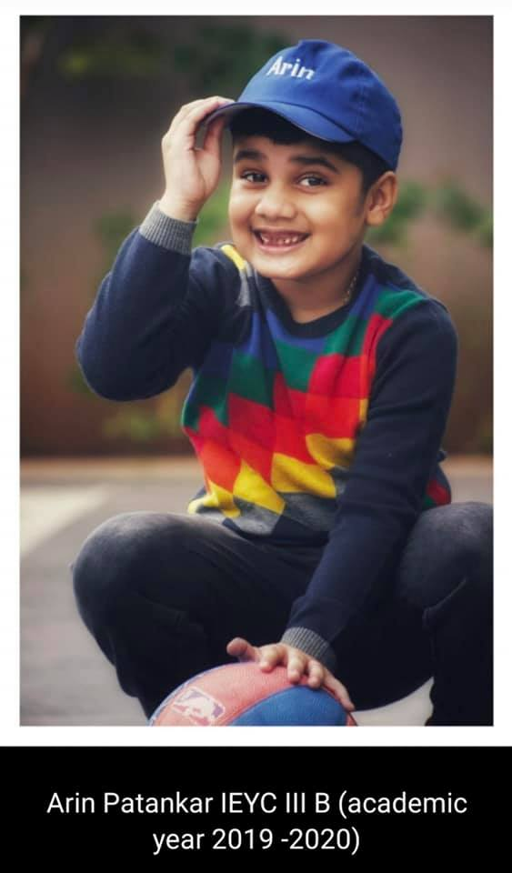
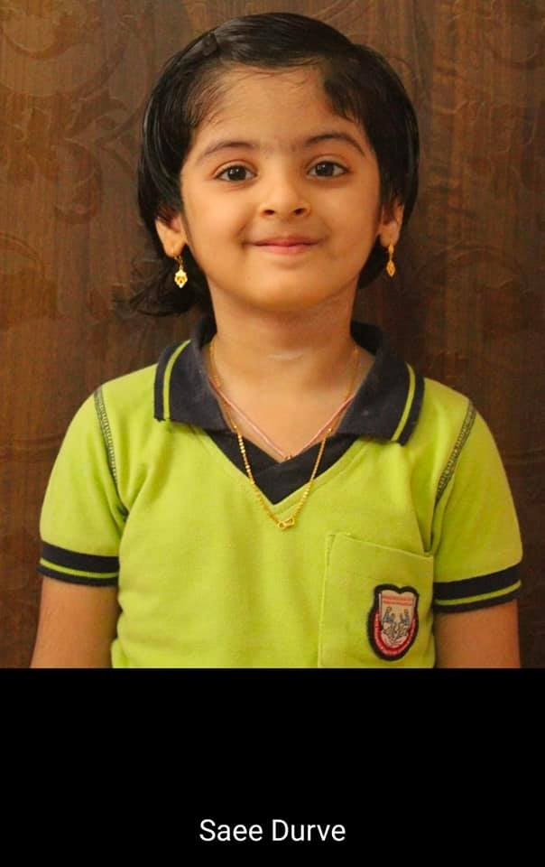
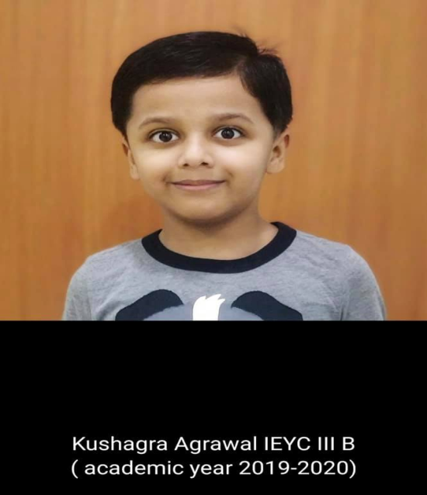
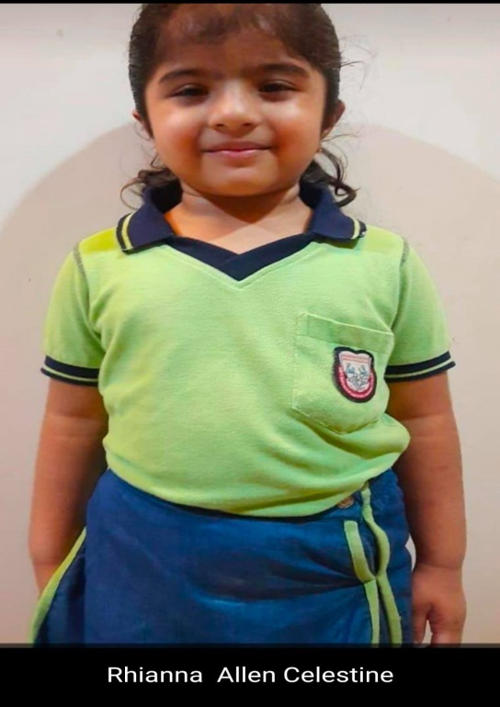
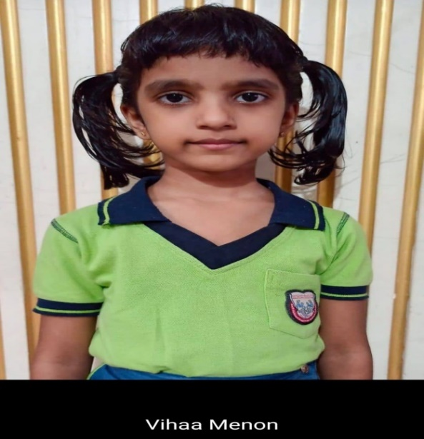
Master Mind Championship (2019-2020)

Slide 28
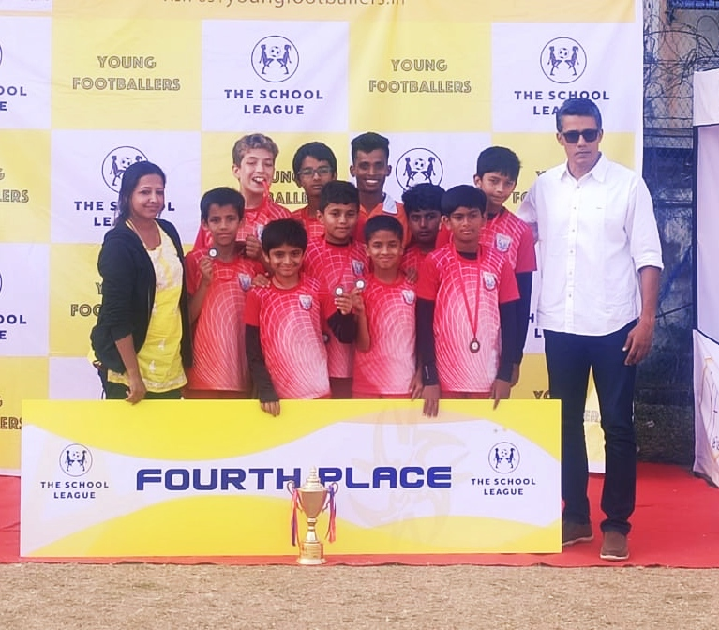
The School League Football Under 12 team

Slide 29
Ms. Nishi Yajnik, from A Levels, winner of the Instagram Weekly Contest held by @delhipoetryslam on the theme 'Indianess'

Slide 30
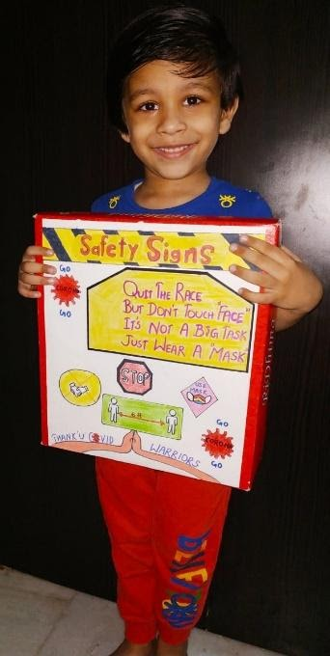
Yagna Siddharth Paliwal of IEYC I - Third position in the Science and Technology Day Inter-School Slogan narration Competition organized by Seven Isles International School.

Slide 31
Priyam Chheda, of CP III -First position in the MISA Inter school skating competition 2019.

Slide 32
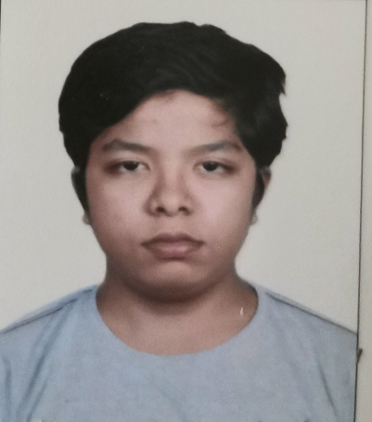
Samvit Mavinkurve from a level has been shortlisted for “Author of the Week” by the editorial team at story mirror for his poem titled ‘The Eternal Truth’.

Slide 33
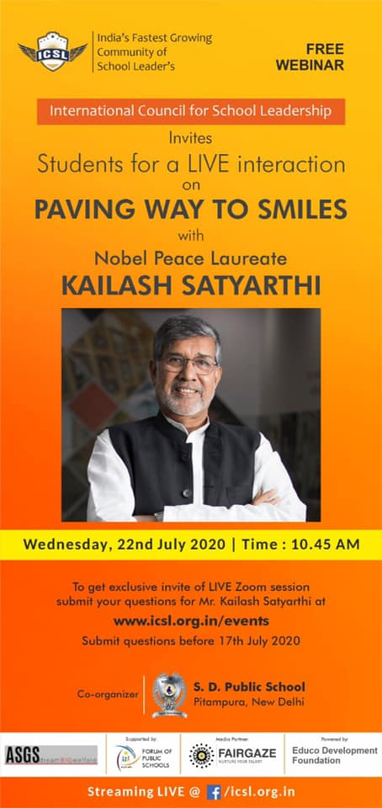
Honeyika Hariani from IGCSE II A ATTENDED a live interactive session with Nobel Peace Laureate Mr Kailash Satyarthi.

Slide 34
advay tripathi frOM CHECKPOINT I secured third place in’ a vos plumes’ french creative writing competition conducted by euro school airoli

Slide 35
The young learners of the Cambridge Primary participated in the Global Social Leaders (GSL) Student Competition, UK AND reached the semi-final of the Competition. THE team - The Gender Benders RECEIVED commendation in the category of Junior Standout.

