Slide 1
ACHIEVEMENTS
2019-2020

Slide 2
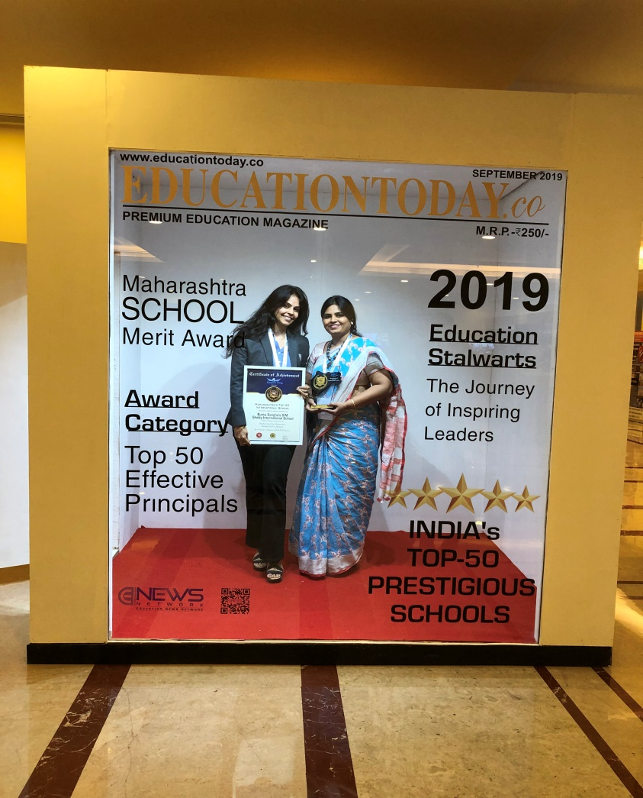
Bunts Sangha’s S.M.Shetty International High School & Junior College, Mumbai ranked no.10th in India and no 9th in Mumbai by Education Today under Maharashtra School Merit Awards for Excellence in Education.

Slide 3
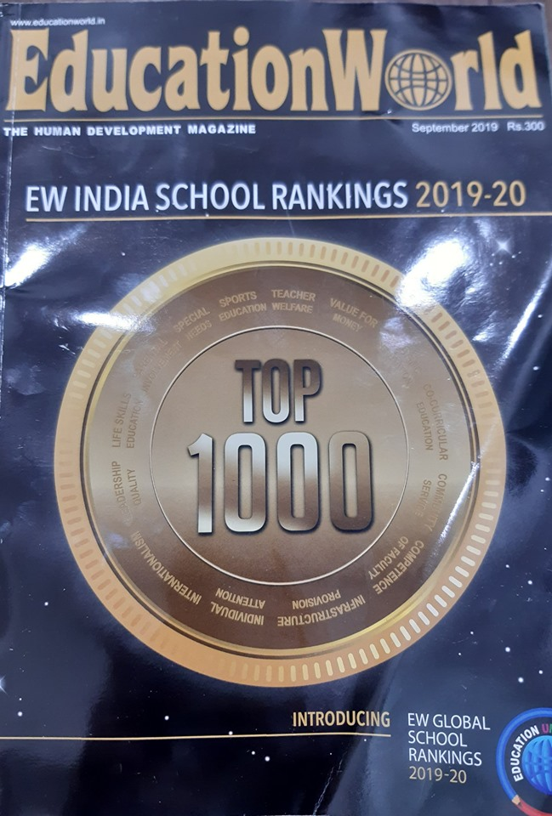
Bunts Sangha's S M Shetty International School and Junior College is Ranked No 36 pan India, Ranked 23 in Maharashtra and Ranked 22 in Mumbai in the category of International Day Schools according to Education World, a leading HumanDevelopment Magazine for the academic year 2019-20.

Slide 4
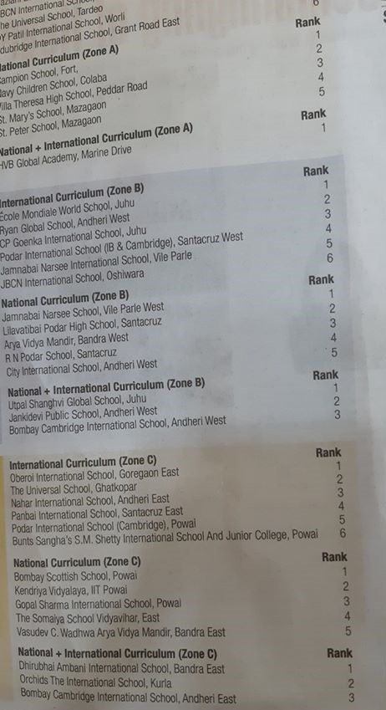
We are proud to announce that our school has been ranked 6th among schools in Zone C offering the International Curriculum in the recently conducted TIMES School Survey 2019 published on 22nd October 2019. We are grateful to our Management, faculty, students and parents who are instrumental in the success story of our school.

Slide 5
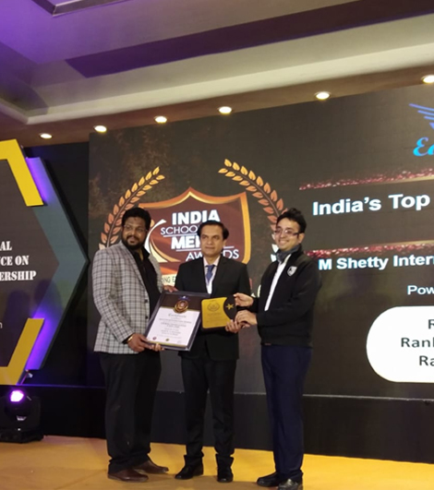
TIMES EDUCATION ICON AWARD 2019

Slide 6
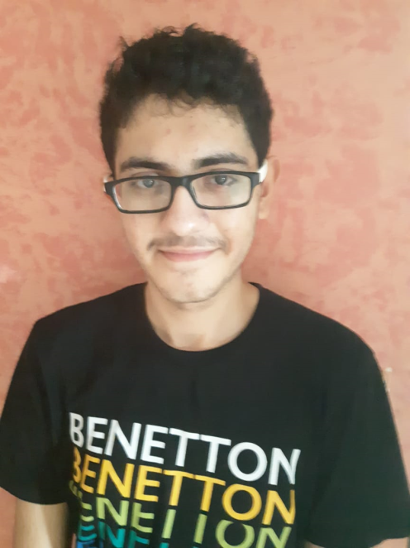
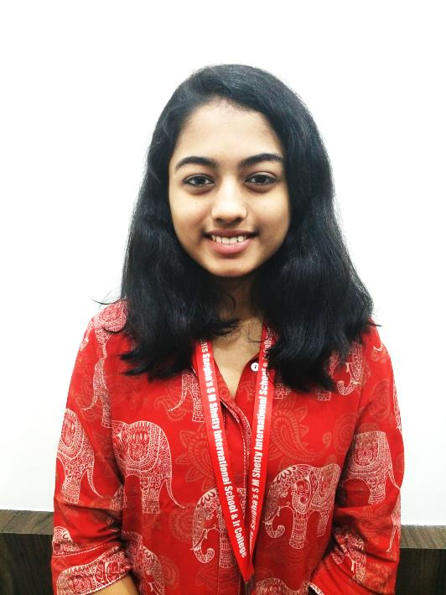
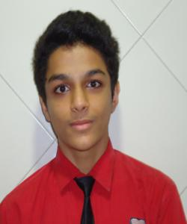
IGCSE, A-LEVEL and IBDP
2018-2019
RACHIT MEHTA
88%
POOJA NAIR
94%
KRITHIK JAIN
34 POINTS

Slide 7
Mr. Rachit Mehta has been awarded the Cambridge Outstanding Learners Award in the Top of the World Category with a score 100/100 in Mathematics at the IGCSE Examination.

Slide 8
Ms.Arya Nair from IGCSE II won the Hindustan Times Scholarship of Rs.50,000/- for her essay on ‘ are we too dependent on our computers and mobile phones’.

Slide 9
At the Cambridge Checkpoint exams 5 students scored 6/6 in English, Mathematics and Science at Primary and Secondary Checkpoint

Slide 11
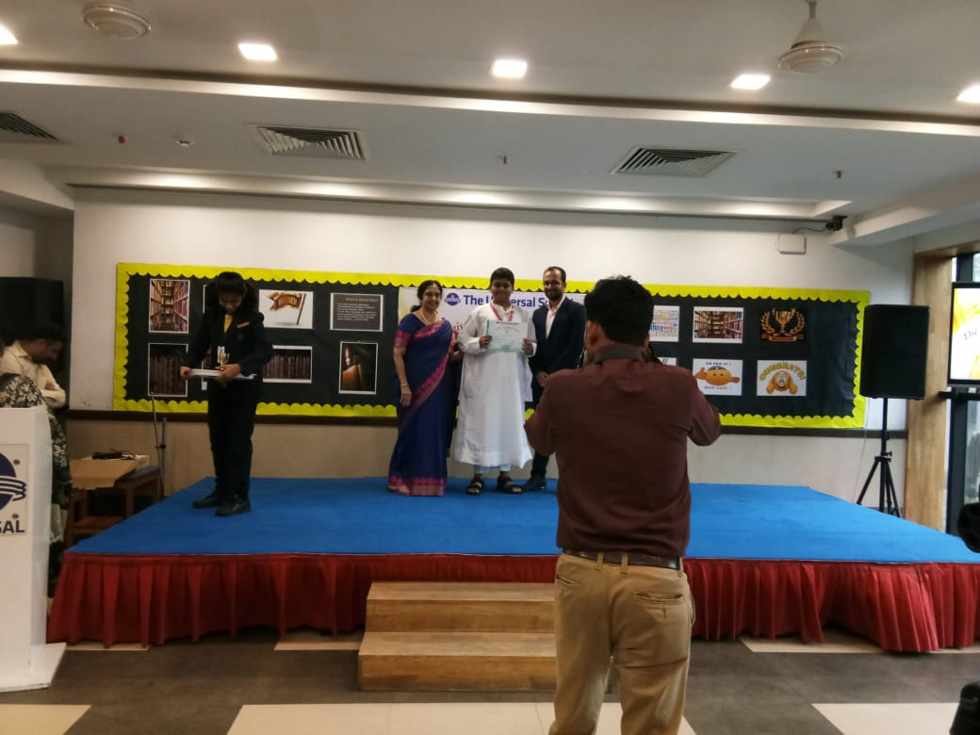
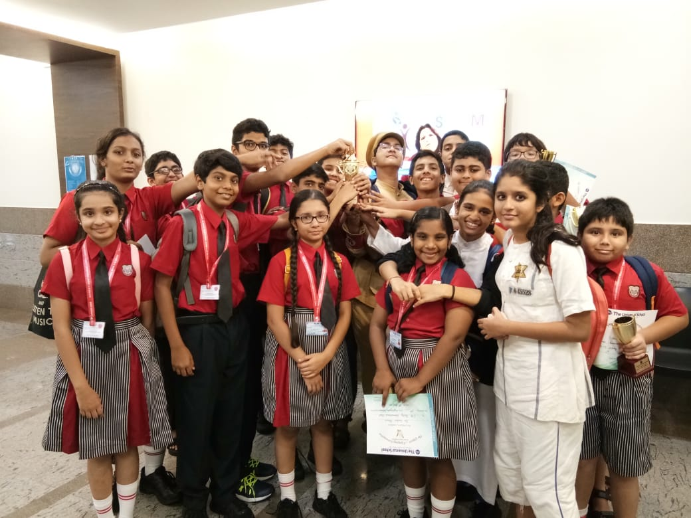
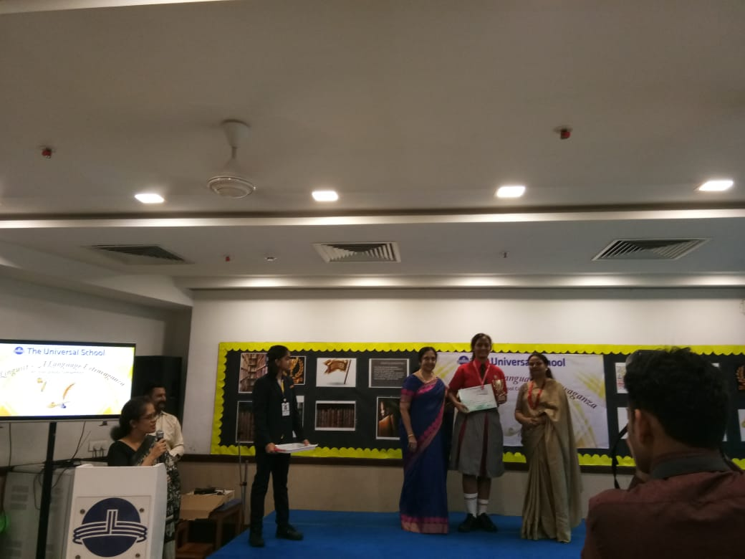
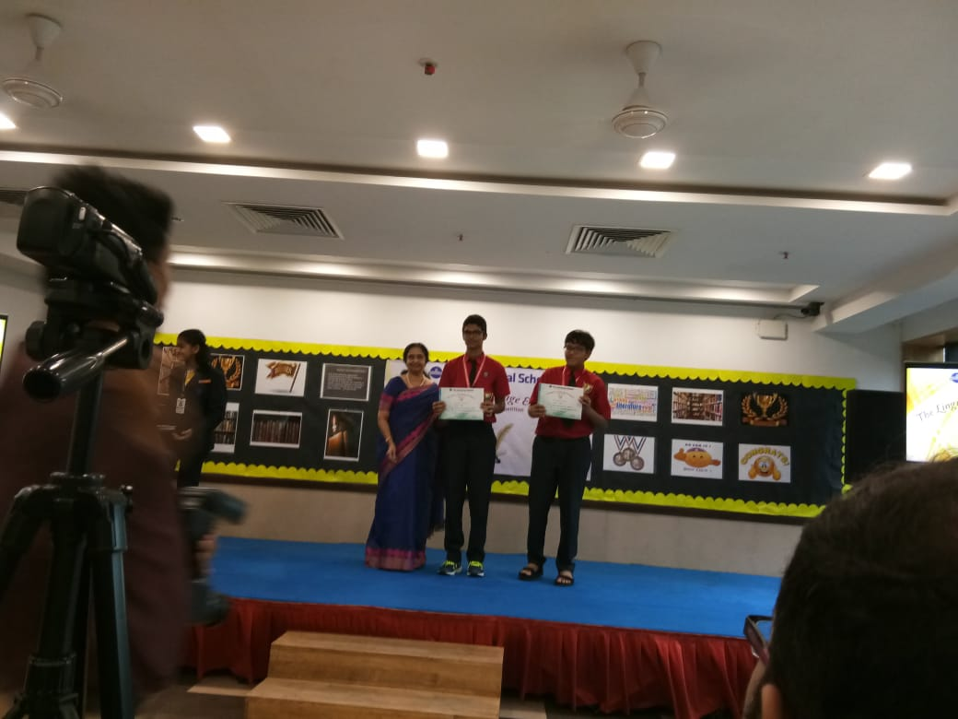
Interschool competition “THE LINGUIST- A LANGUAGE EXTRAVAGANZA” was held on 3rd August 2019 in The Universal School, Mumbai.

Slide 12
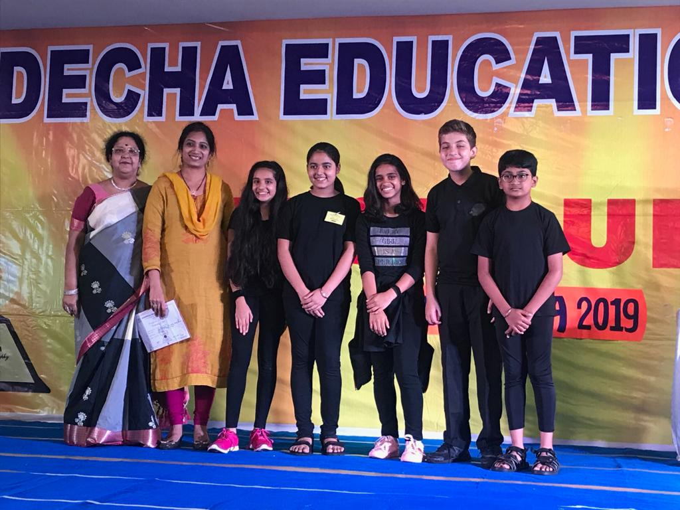
Our students participated in an Interschool competition Vistaura-2019 “Excellentia” held in Gundecha Education Academy on 30th August,2019.

Slide 13
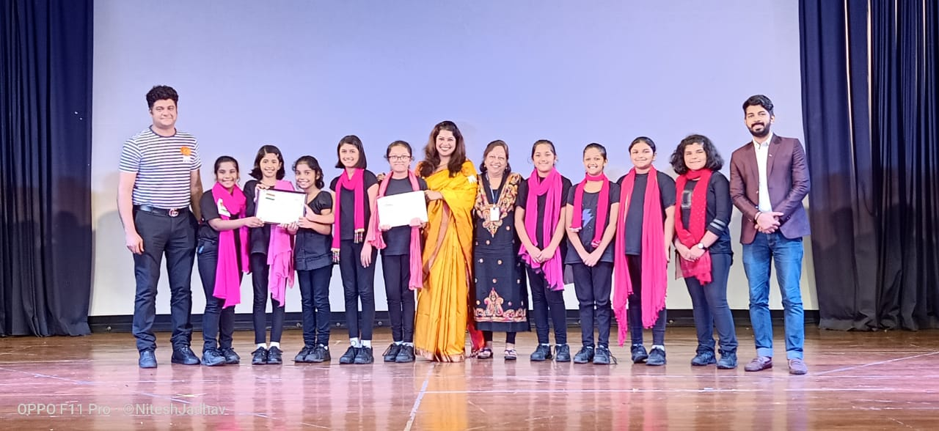
Namaste India 2019, Inter school competition for Dance and Music organized by Pawar Public School, Mumbai

Slide 14
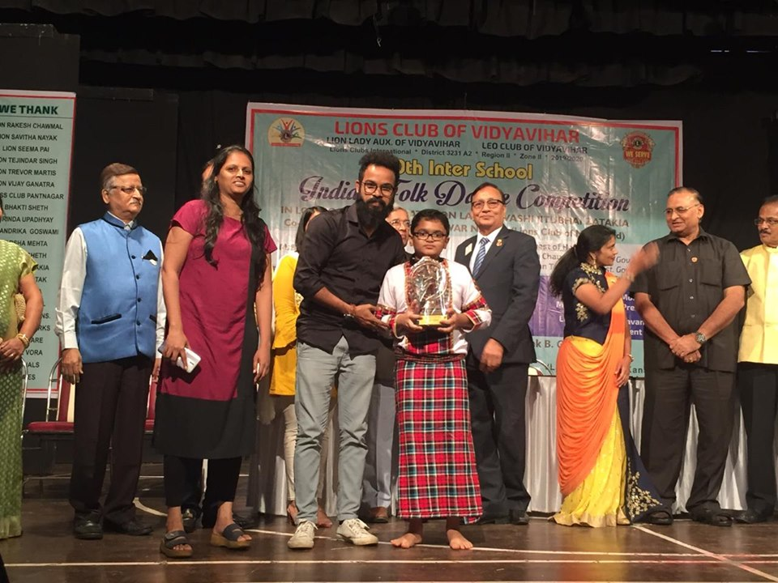
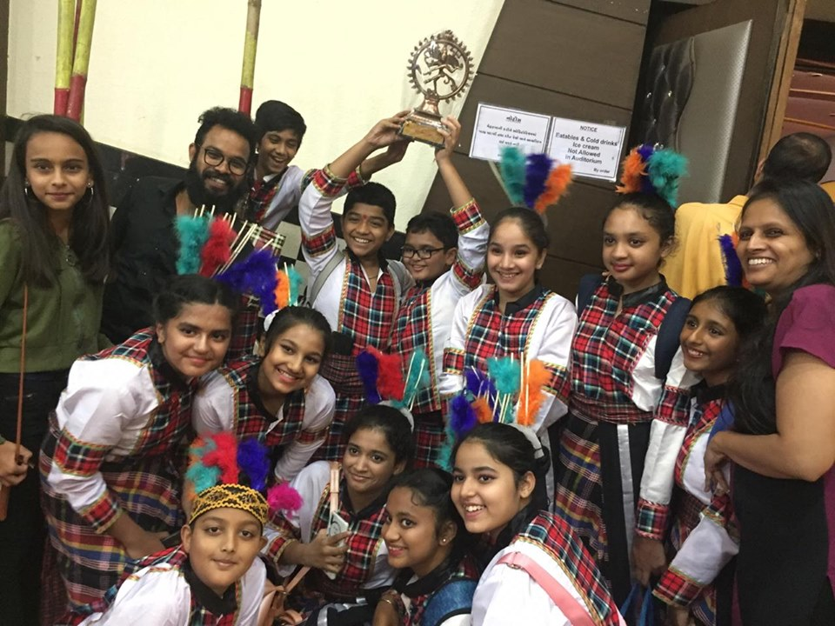
Our School won 'Best Choreography Award' at the 10th Lions Inter School Folk Dance Competition organized by Lions Club, Vidyavihar, Mumbai

Slide 15
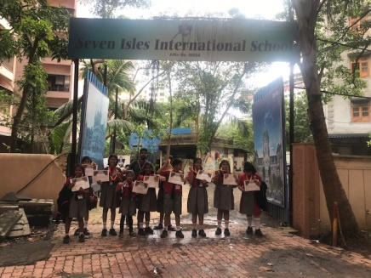
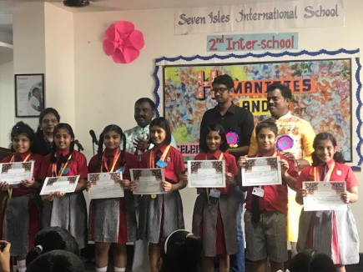
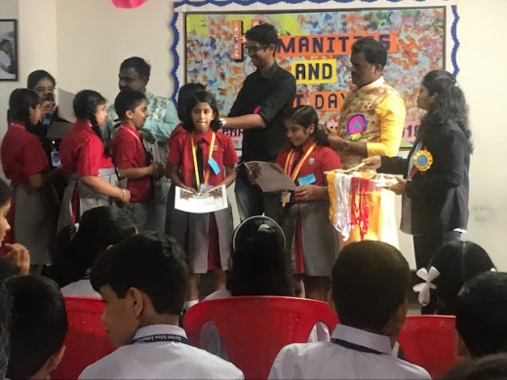
Our students participated in an inter-school Art and Humanities day competition organized by Seven Isles International School and won many prizes exhibiting their skills in multi-disciplinary areas.

Slide 16
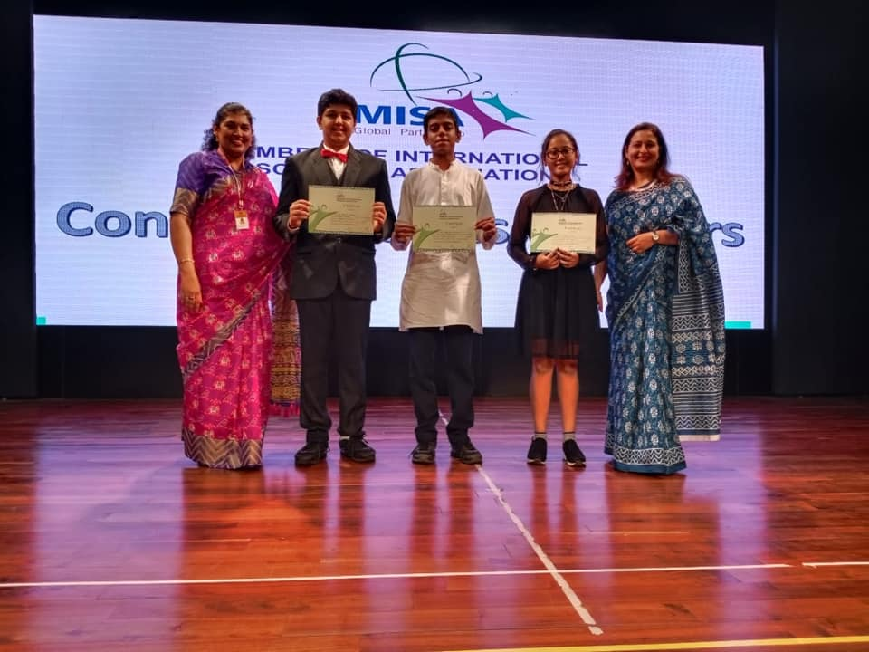
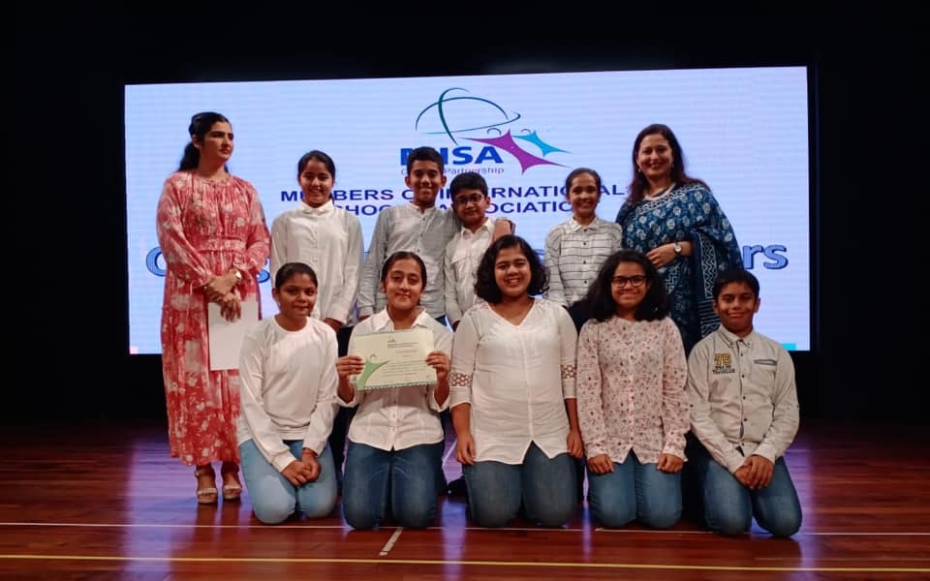
MISAESTHETICS

Slide 17
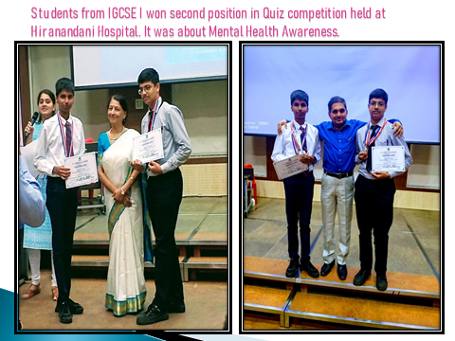
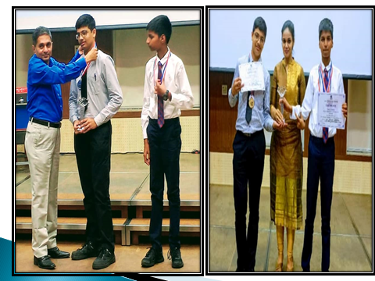

Slide 18
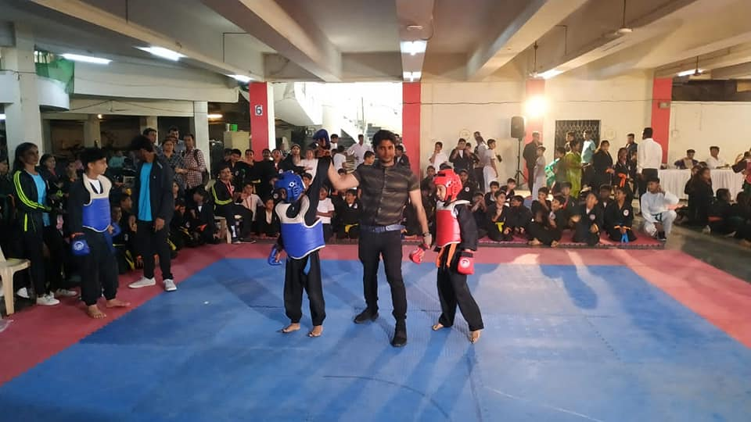
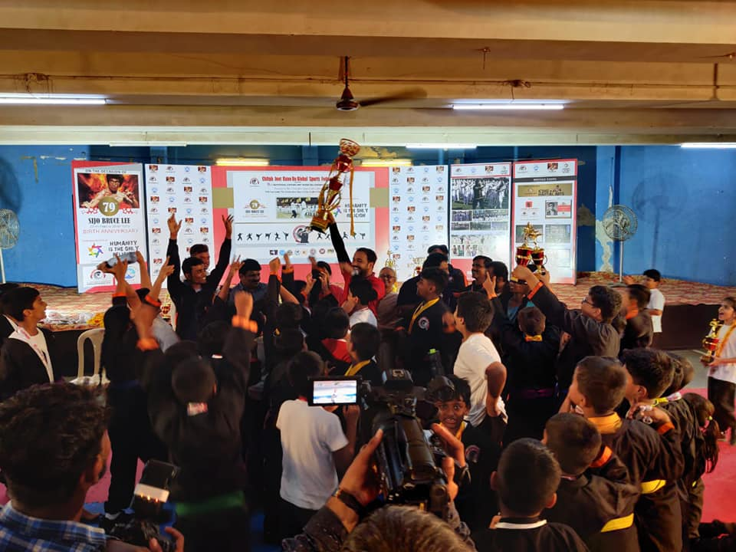
Martial Arts

Slide 19
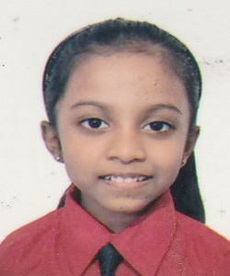
Ms. Khushi Krishna from CP – IV D won IX Rank in Maharashtra State Championship,2018-2019 of the Marrs International Spelling Bee in Category III

