Slide 1
ACHIEVEMENTS
2018-2019

Slide 2
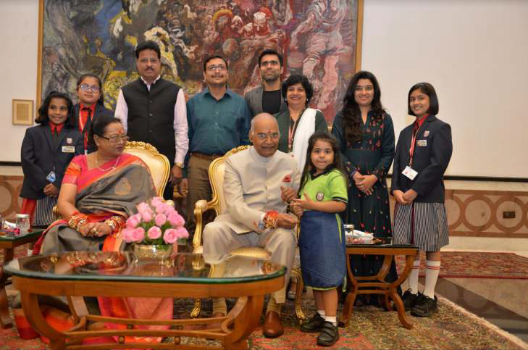
PROUD MOMENT - VISIT TO RASHTRAPATI BHAVAN

Slide 3
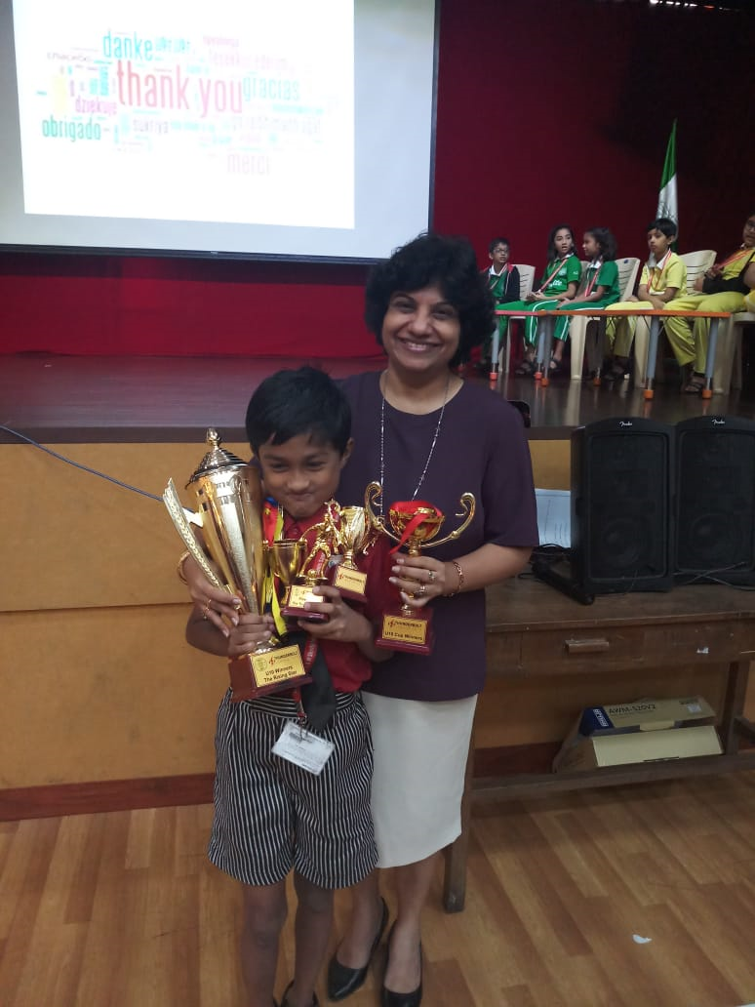
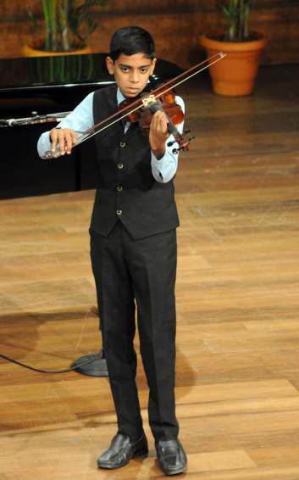
Benedict D’Souza-Budding Brigade Concert at NCPA
Vignesh Chettiar- Budding Star in Football and Cricket

Slide 4
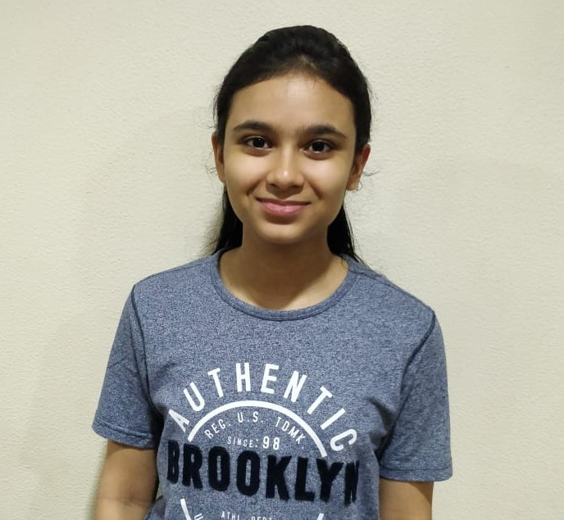
The Student's Digest is a website which covers the success stories of toppers of all the boards.Our school topper from IGCSE II Sanjotkaur Pruthi 's article is published in this website.

Slide 5
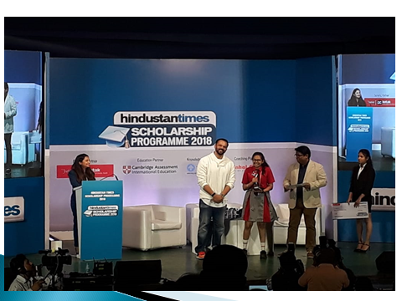
Arya Nair of IGCSE II won a scholarship of Rs.50000/- by Hindustan Times . She was felicitated on 10th December at Rang Sharda.

Slide 6
Abhir Ghalke - Now in CP I was awarded 6th Rank at National Level for MaRRs Play2 Learn - UKG for the academic year 2017-18
IBDP Alumni Reet Sharma’s poem was selected by Project Education for their International magazine IMPACT

Slide 7
Model United Nations Conferences
Hiranandani Foundation School MUN 2018
Rushat Rai (A Level) got ‘Best Delegate award' and Shushrut Devadiga( A Level ) got the 'Special Mention award'.
Global Confluence MUN 2018
Ifrah Chaudhury ( A Level ) got a ‘Verbal Mention'.

Slide 8
Outstanding results in Cambridge Primary and Secondary Checkpoint Examination conducted in April 2018 . 111 students appeared in all.
5 students achieving 6 on 6 in all three subjects: English Mathematics and Science.
Students achieving 6/6
English – 9
Mathematics- 30
Science – 40

Slide 9
School received the Arogya Healthy Workplace Award for creating conducive working atmosphere for all employees.
Principal Ms. Mildred Lobo received the Vocational excellence award instituted by Rotary Club Powai, Mumbai.
Ms Sanjotkaur Pruthi’s interview on Tips for Students was published in the magazine Student’s Digest.

Slide 10
The school has been recognized as the 7th best International School in Maharashtra, 7th in Mumbai and the 11th best International School in India by Education Today School Ranking Survey 2018-19.
Our school has been listed among Top 50 Schools that are recognized as 'Future 50 Schools Shaping Success', under the International Curriculum Category.

Slide 11
Martial Arts : Students of Checkpoint and CP participated in Chitah Jeet Kune Do Global Sports Federation National Championship of Martial arts and they got second position.
( Gold : 12, Silver : 13 and Bronze: 4 )

Slide 12
The school has been recognized as the 20th best International School in Maharashtra and the 27th best International School in India by Education World India School Ranking Survey 2018-19.
A sample respondents database of 12,214 educationists, principals, teachers, parents and students in 27 cities and education hubs across India were interviewed to rate the country’s Top 1,000 schools on 14 parameters of education

Slide 13
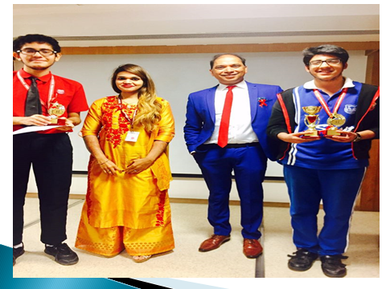
Vedant Ganatra and Rachit Mehta won second position in a debate conducted at Hiranandani Hospital on Topic- HIV Aids

Slide 14
Our school has been listed among Top 50 Schools that are recognized as 'Future 50 Schools Shaping Success', under the International Curriculum Category.
Future 50 Schools Shaping Success is a premium annual evaluation of progressive schools across India conceptualised by industry powerhouses – University (Education Partner), Fortune India (Media Partner) and Pwc (Process Advisers). On the lines of the illustrious Fortune 500 Companies, the Future 50 initiative takes schools through a stringent transparent evaluation process.

Slide 15
Our school has been ranked No 11 in India, No 7 in Maharashtra and No 7 in Mumbai in Category ‘India’s Top 20 International Schools’ in a survey conducted by Education Today co.
The 10 parameters are Academic reputation, Infrastructure provision, Innovative Teaching, Safety and Hygiene, Individual attention, Sports education, Value for Money, Holistic Development, Leadership Management quality and Co-curricular activities.

Slide 16
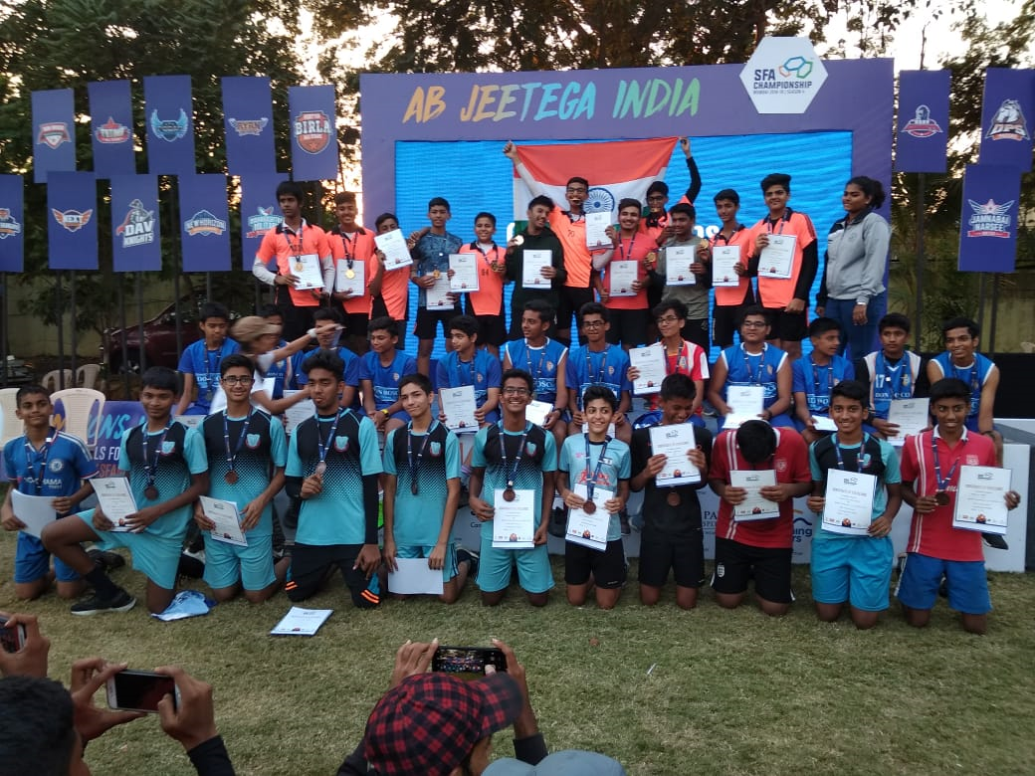
The U-16 Girls and Boys team have won bronze medals in Handball in SFA tournament
For MSSA, Under 16 basketball team of girls won second round and qualified for quarter final.

Slide 17
Rahil Baig from Check Point III won Second position in Long Jump at Reliance Athletic Meet and he secured third place in 80 mts hurdle race in Prabodhan Athletic meet at Goregaon.
33 students participated for MSSA athletics meet on 23rd to 25th November 2018. This was our first initiative towards Athletics as an individual event.

